Slide 1

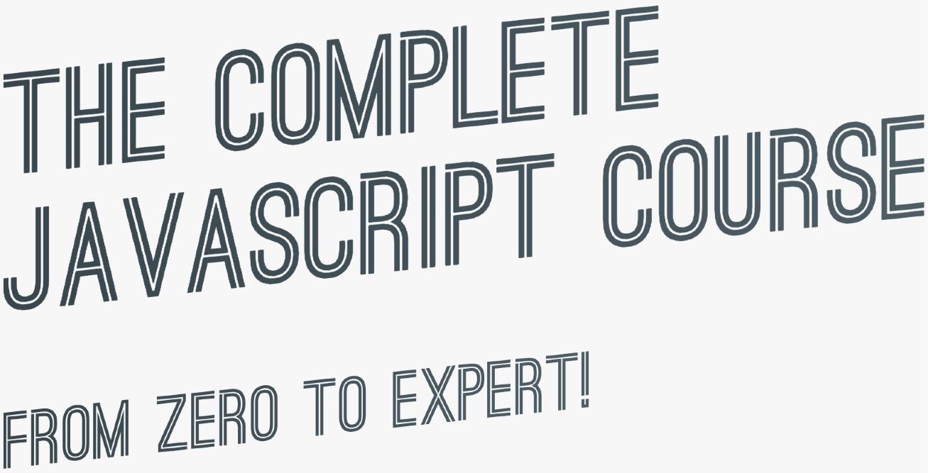

slides for
theory lectures

Slide 2

TABLE OF CONTENTS: THEORY LECTURES
 | 19 | Summary: Which Data Structure to Use? | 37 | How the Web Works: Requests and Responses
² A Brief Introduction to JavaScript | 20 | First-Class and Higher-Order Functions | 38 | Promises and the Fetch API
³ Data Types | 21 | Closures | 39 | Asynchronous Behind the Scenes: The Event Loop
⁴ Boolean Logic | 22 | Data Transformations: map, filter, reduce | 40 | An Overview of Modern JavaScript Development
⁵ JavaScript Releases: ES5, ES6+ and ESNext | 23 | Summary: Which Array Method to Use? | 41 | An Overview of Modules in JavaScript
⁶ Functions Calling Other Functions | 24 | How the DOM Really Works | 42 | Modern, Clean and Declarative JavaScript Programming
⁷ Reviewing Functions | 25 | Event Propagation: Bubbling and Capturing | 43 | Forkify: Project Overview and Planning
⁸ Learning How to Code | 26 | Efficient Script Loading: defer and async | 44 | The MVC Architecture
9 How to Think Like a Developer | 27 | What is Object-Oriented Programming? | 45 | Event Handlers in MVC: Publisher-Subscriber Pattern
¹⁰ Debugging (Fixing Errors) | 28 | OOP in JavaScript | 46 | Forkify Project: Final Considerations
¹¹ What's the DOM and DOM Manipulation | 29 | Prototypal Inheritance and The Prototype Chain
12 An high-level Overview of JavaScript | 30 | Object.create
¹³ The JavaScript Engine and Runtime | 31 | Inheritance Between "Classes": Constructor Functions
¹⁴ Execution Contexts and The Call Stack | 32 | Inheritance Between "Classes": Object.create
¹⁵ Scope and The Scope Chain | 33 | ES6 Classes summary
¹⁶ Variable environment: Hoisting and The TDZ | 34 | Mapty Project: How to Plan a Web Project
¹⁷ The this Keyword | 35 | Mapty Project: Final Considerations
¹⁸ Primitives vs. Objects (Primitive vs. Reference Types) | 36 | Asynchronous JavaScript, AJAX and APIs

Slide 3
WELCOME

Slide 4


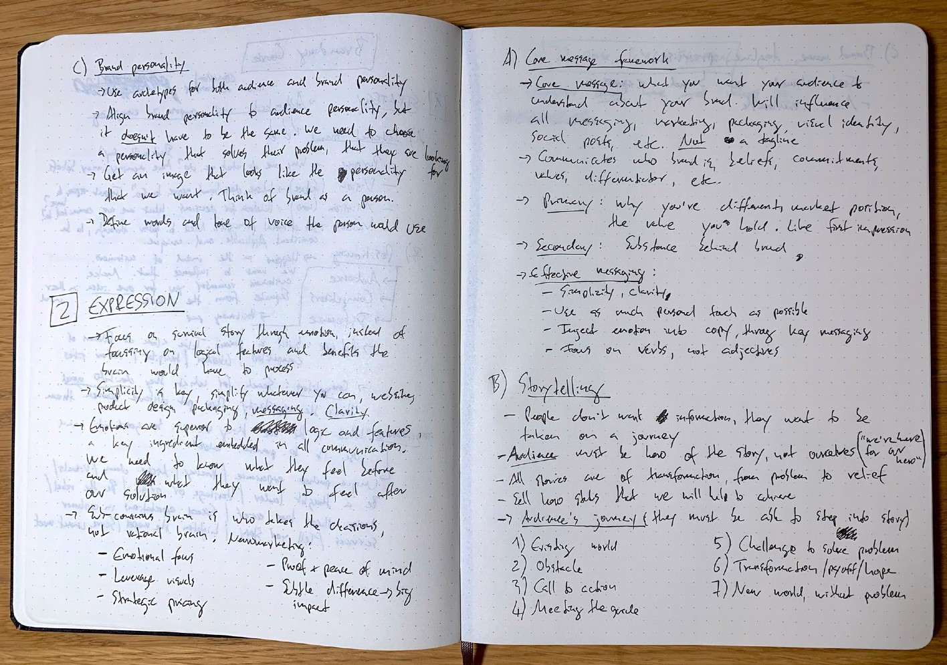

SOME QUICK CONSIDERATIONS BEFORE WE START...
If you want the course material to stick, take notes. Notes on code syntax, notes on theory concepts, notes on everything!
Totally non-coding... Try to understand a single word

Slide 5


SOME QUICK CONSIDERATIONS BEFORE WE START...
If this is your first time ever programming, please don’t get overwhelmed. It’s 100% normal that you will not understand everything at the beginning. Just don’t think “I guess coding is not for me”!

Slide 6

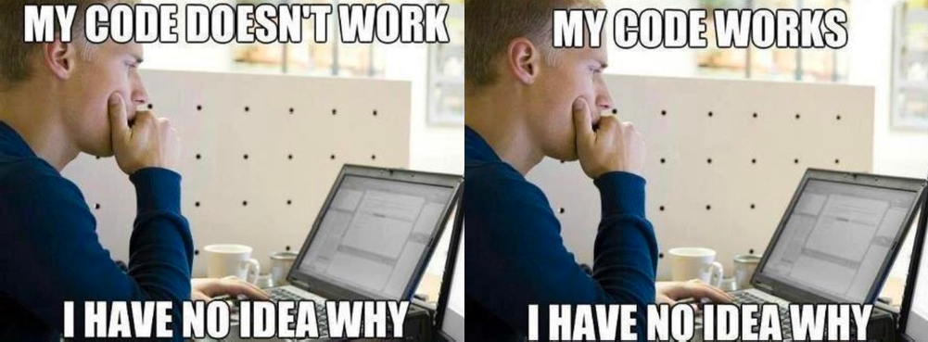
SOME QUICK CONSIDERATIONS BEFORE WE START...
In the first sections of the course, don’t bother understanding WHY things work the way they do in JavaScript. Also, don’t stress about efficient code, or fast code, or clean code. While learning, we just want to make things WORK. We will understand the WHY later in the course.

Slide 7

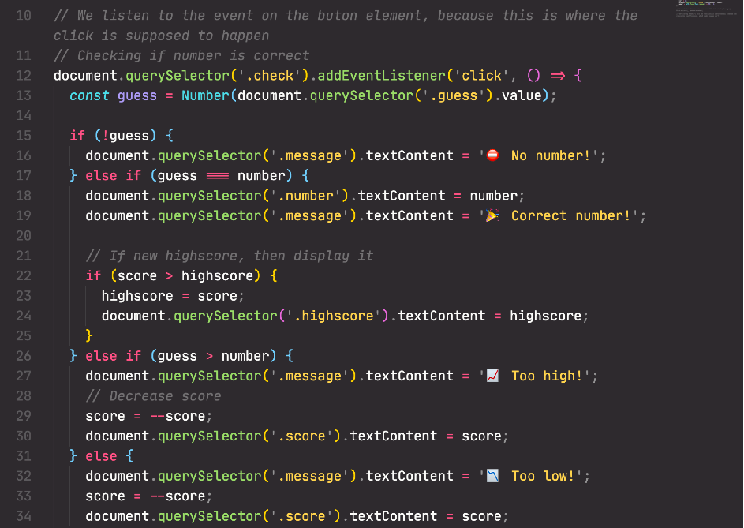
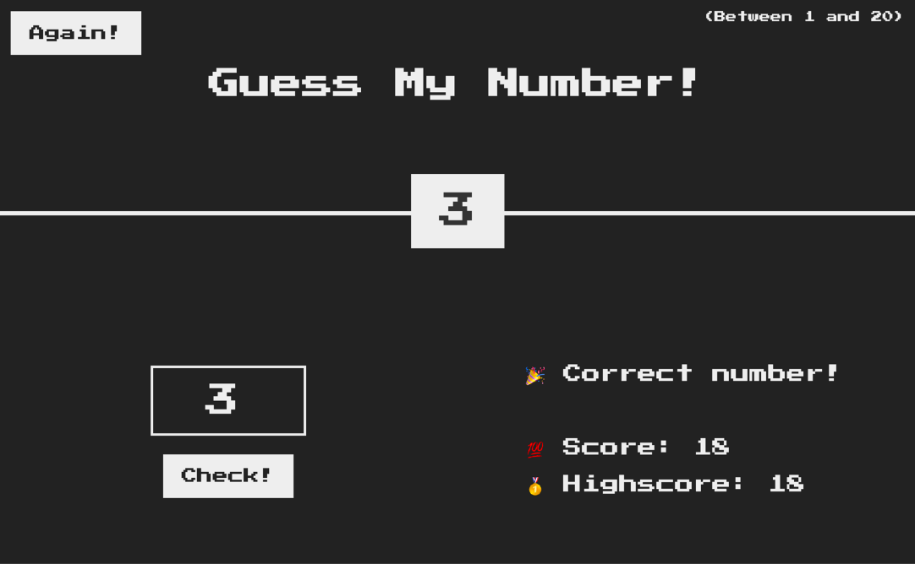

SOME QUICK CONSIDERATIONS BEFORE WE START...
Before moving on from a section, make sure that you understand exactly what was covered. Take a break, review the code we wrote, review your notes, review the projects we built, and maybe even write some code yourself.

Slide 8



SOME QUICK CONSIDERATIONS BEFORE WE START...
Most importantly, have fun! It’s so rewarding to see something that YOU have built YOURSELF! So if you’re feeling frustrated, stop whatever you’re doing, and come back later!
And I mean REAL fun

Slide 9
JAVASCRIPT
FUNDAMENTALS – PART 1

Slide 10
SECTION
JAVASCRIPT FUNDAMENTALS – PART 1
LECTURE
A BRIEF INTRODUCTION TO JAVASCRIPT

Slide 11




WHAT IS JAVASCRIPT?
We don’t have to worry about complex stuff like memory management
JAVASCRIPT
JAVASCRIPT IS A HIGH-LEVEL, OBJECT-ORIENTED, MULTI-PARADIGM PROGRAMMING LANGUAGE.
We can use different styles of programming
Based on objects, for storing most kinds of data
Instruct computer to do things

Slide 12


THE ROLE OF JAVASCRIPT IN WEB DEVELOPMENT
NOUNS
<p></p>
means “paragraph”
CONTENT
ADJECTIVES
p {color: red}
means “the paragraph text is red”
VERBS
p.hide();
means “hide the paragraph”
PRESENTATION
PROGRAMMING LANGUAGE: BUILDING WEB APPLICATIONS

Slide 13
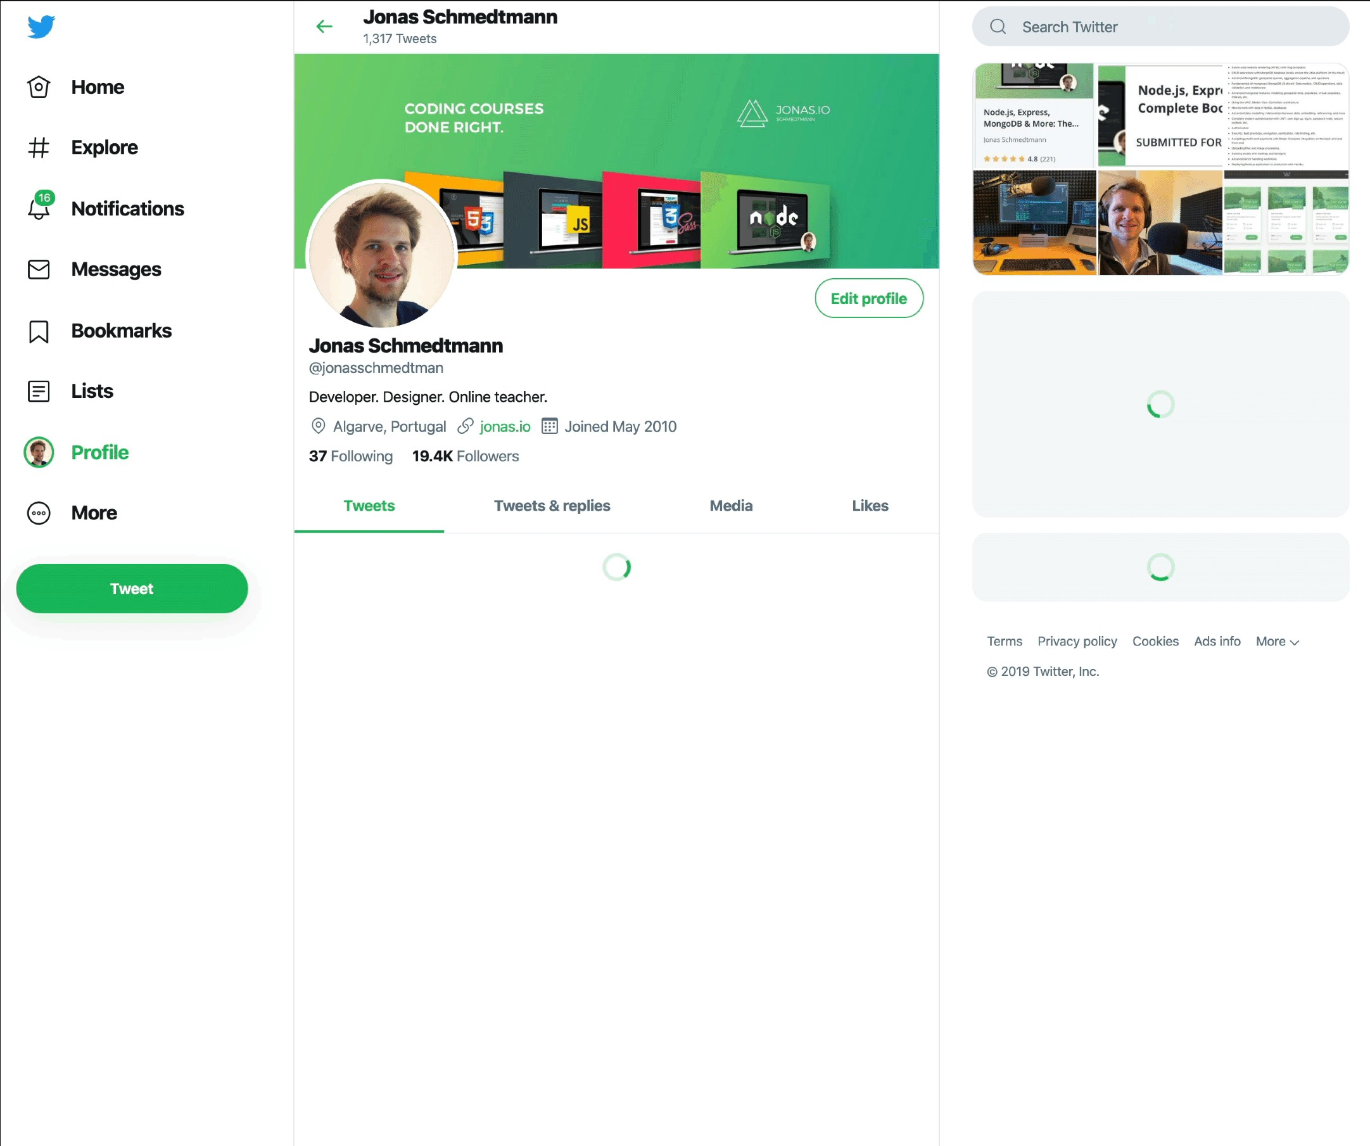
EXAMPLE OF DYNAMIC EFFECTS / WEB APPLICATION
Display user info on hover
Show spinner + loading data in the background
Show spinner + loading data in the background
Show data after loading
Show tweet box after clicking
Display tweets after loading data

Slide 14
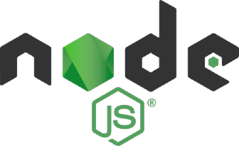





THERE IS NOTHING YOU CAN’T DO WITH JAVASCRIPT (WELL, ALMOST…)
Front-end apps
Back-end apps
Dynamic effects and web applications in the
browser
Web applications on web servers
THIS COURSE
100% based on JavaScript. They might go away, but JavaScript won’t!
Native mobile applications
Native desktop applications

Slide 15


JAVASCRIPT RELEASES... (MORE ABOUT THIS LATER)
Biggest update to the language EVER
New updates to JS every single year
ES6/ ES2015
ES7/ ES2016
ES8/ ES2017
ES9/ ES2018
ES10/ ES2019
ES11/ ES2020
...
ES5
...
Modern JavaScript
ECMAScript
Learn modern JavaScript from the beginning, but without forgetting the older parts!
Let’s finally get started!

Slide 16
SECTION
JAVASCRIPT FUNDAMENTALS – PART 1
LECTURE
DATA TYPES

Slide 17
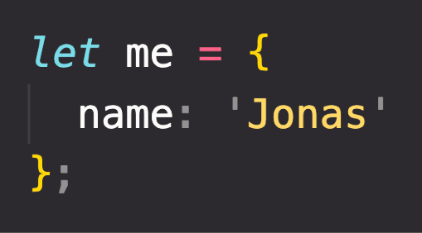
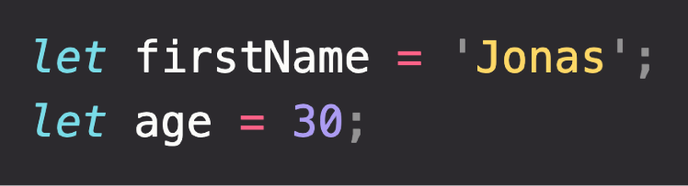
OBJECTS AND PRIMITIVES
VALUE
EVERYTHING ELSE
OBJECT
OR
PRIMITIVE

Slide 18

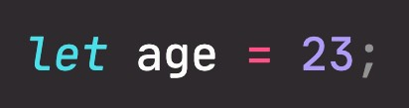

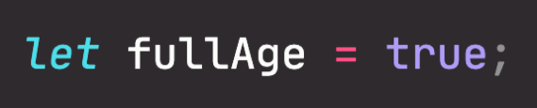


THE 7 PRIMITIVE DATA TYPES
Number: Floating point numbers
String: Sequence of characters
Used for decimals and integers
Used for text
Boolean: Logical type that can only be true or false Used for taking decisions
Undefined: Value taken by a variable that is not yet defined (‘empty value’)
Null: Also means ‘empty value’
Symbol (ES2015): Value that is unique and cannot be changed [Not useful for now]
BigInt (ES2020): Larger integers than the Number type can hold
JavaScript has dynamic typing: We do not have to manually define the data type of the value stored in a variable. Instead, data types are determined automatically.
Value has type, NOT variable!

Slide 19
SECTION
JAVASCRIPT FUNDAMENTALS – PART 1
LECTURE
BOOLEAN LOGIC

Slide 20

BASIC BOOLEAN LOGIC: THE AND, OR & NOT OPERATORS
A AND B A OR B
NOT A, NOT B
“Sarah has a driver’s license
AND good vision”
“Sarah has a driver’s license
OR good vision”
Possible values
Inverts true/false value
A
A
OR | TRUE | FALSE
TRUE | TRUE | TRUE
FALSE | TRUE | FALSE
AND TRUE
FALSE
B
TRUE
TRUE
FALSE
Results of
B
operation,
depending on
EXAMPLE:
A: Sarah has a driver’s license
B: Sarah has good vision
FALSE FALSE FALSE
2 variables
true when ALL are true
true when ONE is true
Boolean variables that can be either TRUE or FALSE
No matter how many variables

Slide 21

AN EXAMPLE
A
BOOLEAN VARIABLES
A: Age is greater or equal 20
B: Age is less than 30
age = 16
false
AND TRUE
FALSE
true
B
TRUE
TRUE
FALSE
LET’S USE OPERATORS!
FALSE FALSE FALSE
!A
true
false
A
A AND B
false
false
true
OR TRUE
FALSE
A OR B
true
false
true
!A AND B
true
B
TRUE
TRUE
TRUE
true
true
A OR !B
false
FALSE
TRUE
FALSE
false
false

Slide 22
SECTION
JAVASCRIPT FUNDAMENTALS – PART 1
LECTURE
JAVASCRIPT RELEASES: ES5, ES6+ AND ESNEXT

Slide 23





A BRIEF HISTORY OF JAVASCRIPT
1995
Brendan Eich creates the very first version of JavaScript in just 10 days. It was called Mocha, but already had many fundamental features of modern JavaScript!
1996
Mocha changes to LiveScript and then to JavaScript, in order to attract Java developers. However, JavaScript has almost nothing to do with Java
Microsoft launches IE, copying JavaScript from Netscape and calling it JScript;
1997
With a need to standardize the language, ECMA releases ECMAScript 1 (ES1), the first official standard for JavaScript (ECMAScript is the standard, JavaScript the language in practice);
2009
ES5 (ECMAScript 5) is released with lots of great new features;
2015
ES6/ES2015 (ECMAScript 2015) was released: the biggest update to the language ever!
ECMAScript changes to an annual release cycle in order to ship less features per update
2016 – ∞
Release of ES2016 / ES2017 / ES2018 / ES2019 / ES2020 / ES2021 / … / ES2089

Slide 24
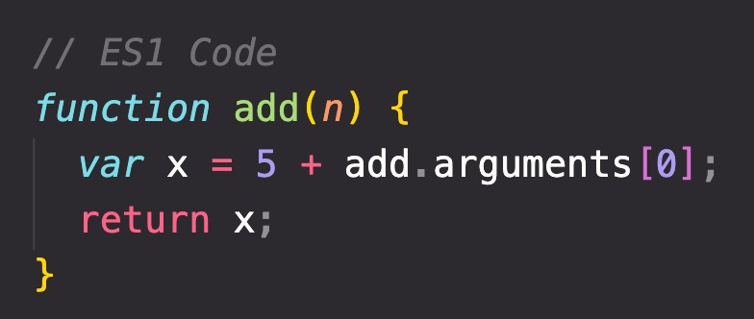



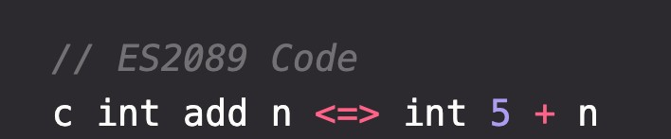
BACKWARDS COMPATIBILITY: DON’T BREAK THE WEB!
Modern JavaScript Engine
BACKWARDS COMPATIBLE
1997
2020
Old features are never removed; Not really new versions, just
incremental updates (releases)
Websites keep working forever!
DON’T BREAK THE WEB!
Modern JavaScript Engine
NOT FORWARDS COMPATIBLE
2020
2089

Slide 25

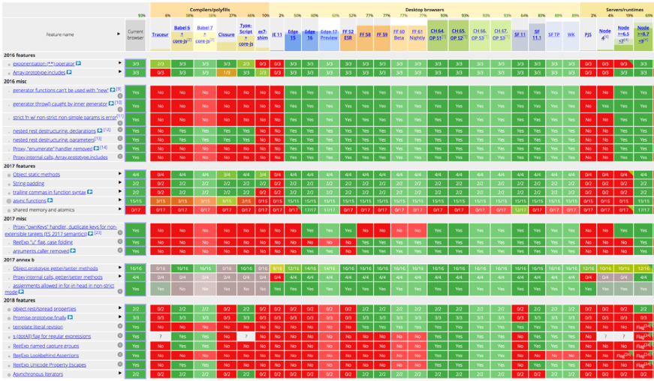
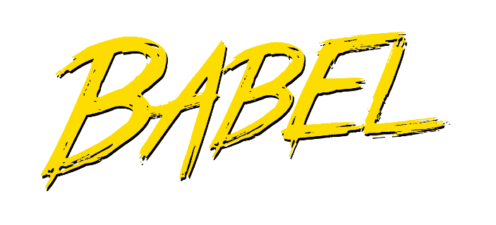

HOW TO USE MODERN JAVASCRIPT TODAY
During development: Simply use the latest Google Chrome!
During production: Use Babel to transpile and polyfill your code (converting back to ES5 to ensure browser compatibility for all users).
http://kangax.github.io/compat-table
Fully supported in all browsers (down to IE 9 from 2011);
Ready to be used today
ES5
ES6/ES2015
↓
ES2020
ES6+: Well supported in all modern browsers; No support in older browsers;
Can use most features in production with transpiling and polyfilling
ESNext: Future versions of the language (new feature proposals that reach Stage 4);
Can already use some features in production with transpiling and polyfilling.
ES2021 – ∞
Will add new videos
(As of 2020)

Slide 26
MODERN JAVASCRIPT FROM THE BEGINNING
Learn modern JavaScript from the beginning!
But, also learn how some things used to be done before modern JavaScript (e.g. const & let vs var and function constructors vs ES6 class).
3 reasons why we should not forget the Good Ol’ JavaScript:
You will better understand how JavaScript actually works; Many tutorials and code you find online today are still in ES5; When working on old codebases, these will be written in ES5.

Slide 27
JAVASCRIPT
FUNDAMENTALS – PART 2

Slide 28
SECTION
JAVASCRIPT FUNDAMENTALS – PART 2
LECTURE
FUNCTIONS CALLING OTHER FUNCTIONS

Slide 29
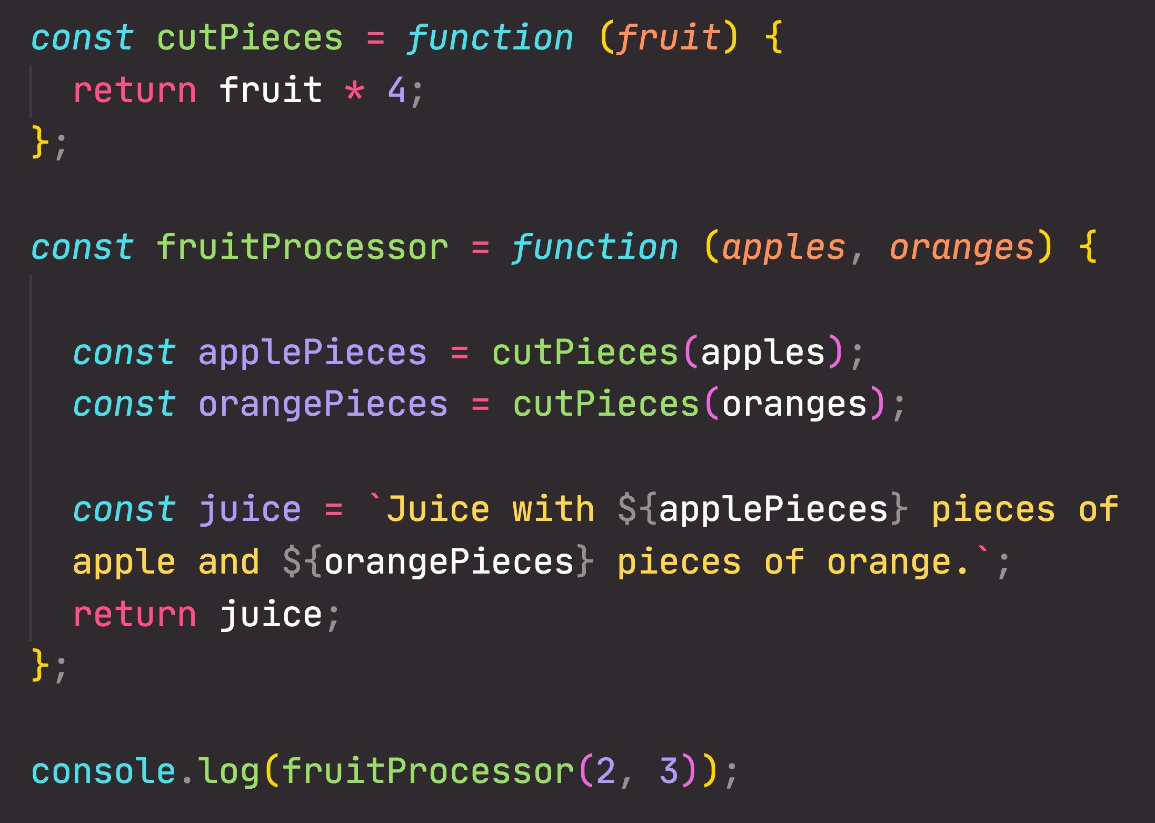

CALLING A FUNCTION INSIDE A FUNCTION: DATA FLOW
2
2
8
2
8
3
8
2

Slide 30
SECTION
JAVASCRIPT FUNDAMENTALS – PART 2
LECTURE
REVIEWING FUNCTIONS

Slide 31
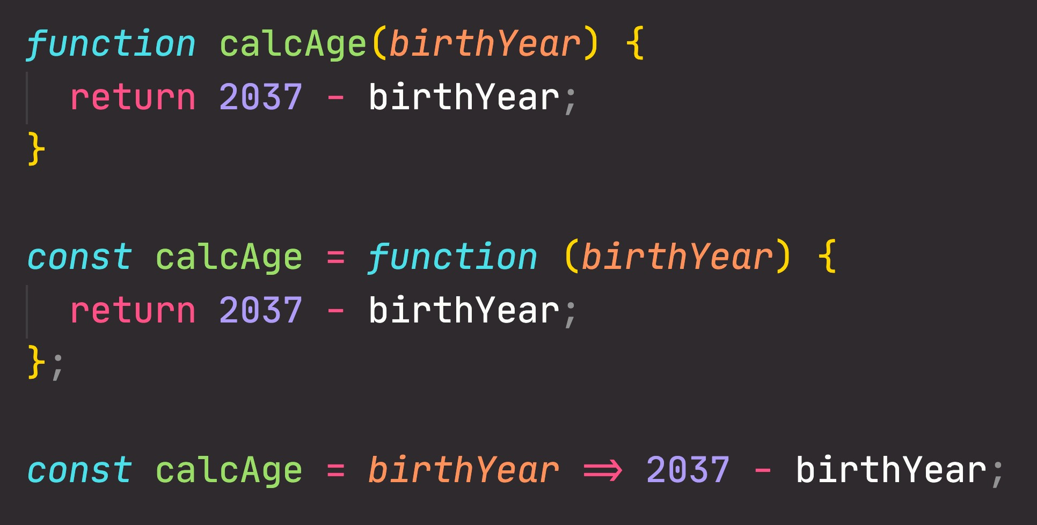
FUNCTIONS REVIEW; 3 DIFFERENT FUNCTION TYPES
Function declaration
Function that can be used before it’s declared
Function expression
Essentially a function
value stored in a variable
Arrow function
Great for a quick one-line functions. Has no this keyword (more later...)
Three different ways of writing functions, but they all work in a similar way: receive input data, transform data, and then output data.

Slide 32
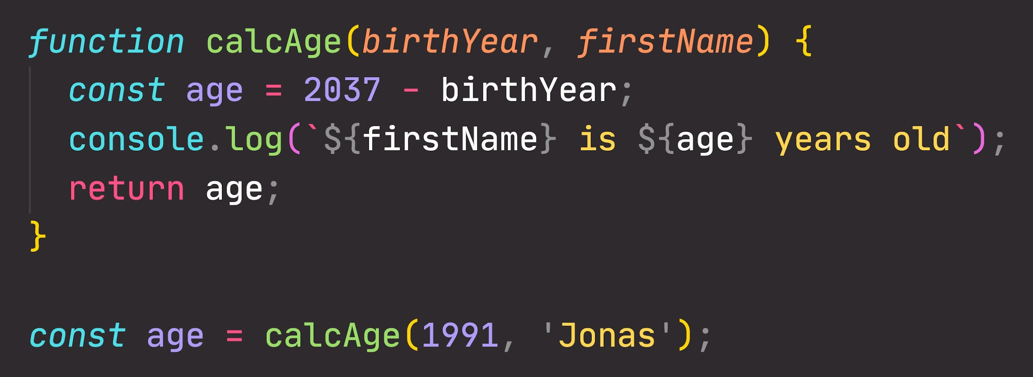
FUNCTIONS REVIEW: ANATOMY OF A FUNCTION
Parameters: placeholders to receive input
values. Like local variables of a function
Function body: block of code that we want to reuse. Processes the function’s input data
Function name
return statement to output a value from the function and terminate execution
Calling, running or invoking the function, using ()
Variable to save returned value (function output)
Arguments: actual values of function parameters, to input data

Slide 33
DEVELOPER SKILLS & EDITOR SETUP

Slide 34
SECTION
DEVELOPER SKILLS & EDITOR SETUP
LECTURE
LEARNING HOW TO CODE

Slide 35




HOW TO FAIL
AT LEARNING HOW TO CODE
He didn’t have a clear goal at the beginning of his journey
He started by watching courses and reading tutorials, but he would just copy the code without caring how it works. Sometimes he would just copy and paste code!
He didn’t reinforce what he was learning by doing small challenges or taking notes He didn’t practice coding, and didn’t come up with his own project ideas
He quickly became frustrated when his code was not perfectly clean or efficient He lost motivation because he thought he could never know everything
He was learning in isolation
John
(not actually…)
After finishing a couple of courses, he thought he now was a web developer and could start applying to jobs. But he couldn’t even build an app on his own!

Slide 36

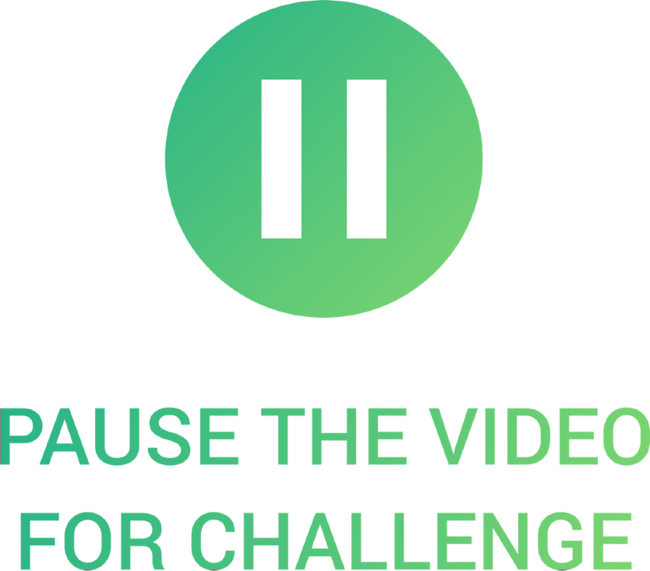

HOW TO SUCCEED AT LEARNING HOW TO CODE
He didn’t have a clear goal at the beginning of his journey
He would just copy the code without caring how it works. Sometimes he would just copy and paste code!
He didn’t reinforce what he was learning by doing small challenges or taking notes
FIX
FIX
Set a specific, measurable, realistic and time-based goal
Know exactly why you are learning to code: Switching careers? Finding a better job?
Imagine a big project you want to be able to build!
Research technologies you need and then learn them
FIX
After you learn a new feature or concept, use it immediately
Understand the code that you’re studying and typing
Take notes
Always type the code, don’t copy-paste!
Challenge yourself and practice with small coding exercises and challenges
Don’t be in a hurry to complete the course fast!

Slide 37

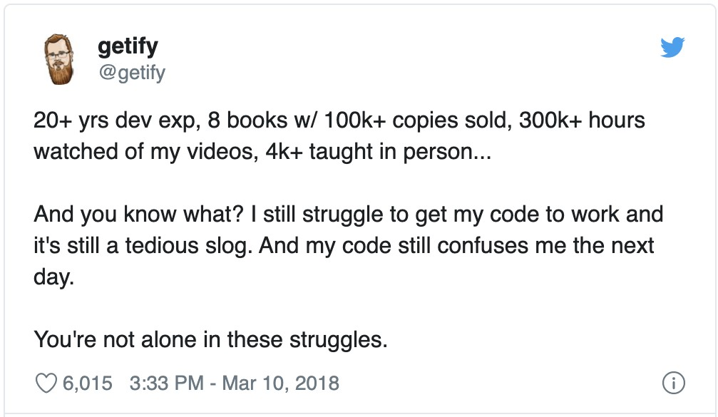
HOW TO SUCCEED AT LEARNING HOW TO CODE
He didn’t practice coding, and didn’t come up with his own project ideas
He quickly became frustrated when his code was not perfectly clean or efficient
He lost motivation because he thought he could never know everything
FIX
FIX
FIX
Practicing on your own is the most important thing to do
Don’t get stuck trying to write the perfect code!
Embrace the fact that you will never you know everything
This is NOT optional! Without practice outside of courses, you won’t go anywhere!
Just write tons of code, no matter the quality!
Just focus on what you need to achieve your goal!
Clean and efficient code will come with time
Come up with your own project ideas or copy popular sites or applications, or just parts of them in the beginning
You can always refactor code later
Don’t be stuck in “tutorial hell”

Slide 38

HOW TO SUCCEED AT LEARNING HOW TO CODE
He was learning in isolation
After finishing a couple of courses, he thought he now was a web developer and could start applying to jobs
FIX
Explain new concepts to other people. If you can explain it, you truly understand it!
Share your goals to make
yourself accountable
Share your learning progress with the web dev community (#100DaysOfCode, #CodeNewbie, #webdev, etc.)
FIX
The biggest misconception
that people have!
Courses are an amazing starting point, but are only the beginning of your journey!
NEXT SLIDE

Slide 39
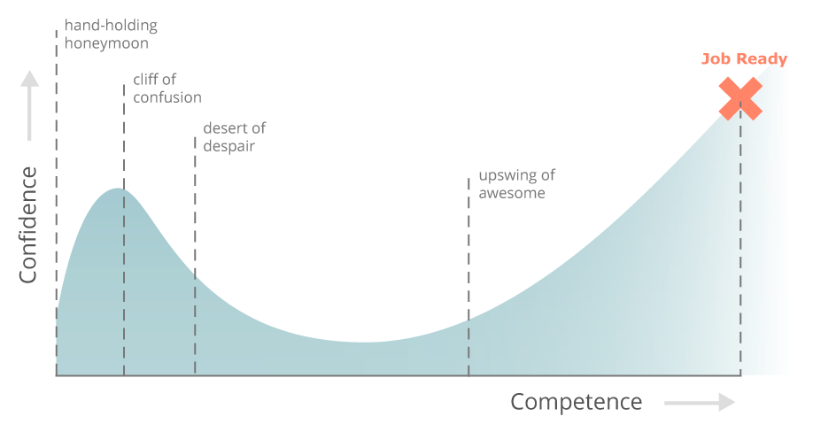
LEARNING HOW TO CODE IS HARD, BUT YOU CAN DO IT!
Study courses: understand code, take challenges and notes
Everything is awesome
Stay motivated! Keep writing lots of code on your own, no matter how bad
JOB READY
Cliff of confusion
Pit of
Learn with other people, devs and beginners, and share progress
despair
Back to awesome
Confidence
Keep challenging yourself, run into lots of problems, and fix them
Round up your skillset with best practices and tools (git, testing, …)
Competence
You’re probably somewhere here
JOB READY
(But the learning never stops )
Source: https://www.thinkful.com/blog/why-learning-to-code-is-so-damn-hard/

Slide 40
SECTION
DEVELOPER SKILLS & EDITOR SETUP
LECTURE
HOW TO THINK LIKE A DEVELOPER: BECOME A PROBLEM SOLVER!

Slide 41

HOW TO FAIL
AT SOLVING PROBLEMS
WHENEVER JOHN ENCOUNTERS A PROBLEM:
Example: In an array of GPS coordinates, find the two closest points
He jumps at the problem without much thinking
He implements his solution in an unstructured way
He gets stressed out when things don’t work He is too proud to research solutions
FIX
Stay calm and slow down, don’t just jump at a problem without a plan
Take a very logical and rational approach (programming is just logic, in the end…)
John can code now
Use my 4-step framework to solve any problem
NEXT SLIDE

Slide 42

4 STEPS TO SOLVE ANY PROBLEM
Make sure you 100% understand the problem. Ask the right questions to get a clear picture of the problem
EXAMPLE
1
Project Manager: “We need a function
whatever
that reverses we pass into it”
1
What does “whatever” even mean in this context? What should be reversed? Answer: Only strings, numbers, and arrays make sense to reverse...
What to do if something else is passed in?
What should be returned? Should it always be a string, or should the type be the same as passed in?
How to recognize whether the argument is a number, a string, or an array?
How to reverse a number, a string, and an array?

Slide 43
4 STEPS TO SOLVE ANY PROBLEM
Make sure you 100% understand the problem. Ask the right questions to get a clear picture of the problem
EXAMPLE
1
Project Manager: “We need a function that reverses whatever we pass into it”
Divide and conquer: Break a big problem into smaller sub-problems.
2
SUB-PROBLEMS:
Check if argument is a number, a string, or an array
2
Implement reversing a number
Implement reversing a string
Implement reversing an array
Return reversed value
Looks like a task list that we need to implement

Slide 44



4 STEPS TO SOLVE ANY PROBLEM
Make sure you 100% understand the problem. Ask the right questions to get a clear picture of the problem
EXAMPLE
1
Project Manager: “We need a function that reverses whatever we pass into it”
Divide and conquer: Break a big problem into smaller sub-problems.
3
How to check if a value is a number in JavaScript?
2
How to check if a value is a string in JavaScript?
How to check if a value is an array in JavaScript?
Don't be afraid to do as much
research as you have to
How to reverse a number in JavaScript?
3
How to reverse a string in JavaScript?
How to reverse an array in JavaScript?

Slide 45
4 STEPS TO SOLVE ANY PROBLEM
Make sure you 100% understand the problem. Ask the right questions to get a clear picture of the problem
EXAMPLE
1
Project Manager: “We need a function that reverses whatever we pass into it”
Divide and conquer: Break a big problem into smaller sub-problems.
4
function reverse(value)
if value type !string && !number && !array
return value
2
if value type == string reverse string
if value type == number reverse number
if value type == array reverse array
Don't be afraid to do as much
research as you have to
3
For bigger problems, write pseudo-code
before writing the actual code
4
return reversed value

Slide 46
SECTION
DEVELOPER SKILLS & EDITOR SETUP
LECTURE
DEBUGGING (FIXING ERRORS)

Slide 47
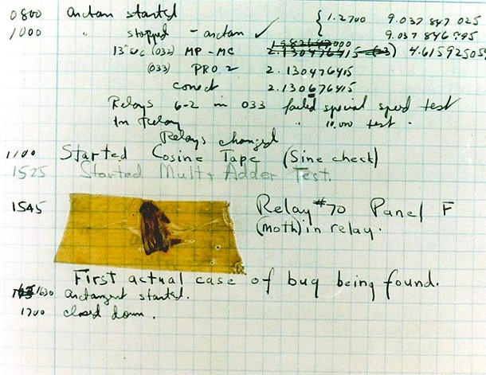

WHAT IS A SOFTWARE BUG?
Software bug: Defect or problem in a computer program. Basically, any unexpected or unintended behavior of a computer program is a software bug.
Bugs are completely normal in software development!
Previous example: “We need a function that reverses whatever we pass into it”
reverse([1, 3, 5, 7])
Unexpected result: the array is scrambled, NOT reversed. So there is a bug in the reverse function
A real bug which was causing an error in Harvard’s computer in the 1940s
[5, 1, 7, 3]
Debugging: Process of finding, fixing and preventing bugs.

Slide 48
THE DEBUGGING PROCESS
Becoming aware that there is a bug
Isolating where exactly the bug is happening in code
Preventing it from happening again
Correct the bug
IDENTIFY
FIND
FIX
PREVENT
During development
Developer console (simple code)
Replace wrong solution with new correct solution
Searching for the same bug in similar code
Testing software
Debugger (complex code)
User reports during production
Writing tests using testing software
Context: browsers, users, etc.

Slide 49
JAVASCRIPT IN THE BROWSER: DOM AND EVENTS
FUNDAMENTALS

Slide 50
SECTION
JAVASCRIPT IN THE BROWSER: DOM AND EVENTS FUNDAMENTALS
LECTURE
WHAT'S THE DOM AND DOM MANIPULATION

Slide 51

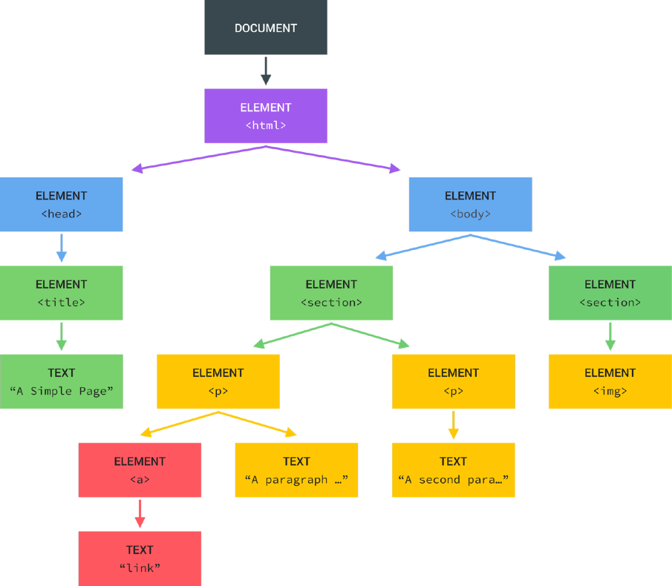
WHAT IS THE DOM?
DOCUMENT OBJECT MODEL: STRUCTURED REPRESENTATION OF HTML DOCUMENTS. ALLOWS JAVASCRIPT TO ACCESS HTML ELEMENTS AND STYLES TO MANIPULATE THEM.
Tree structure, generated by browser on HTML load
DOM
Change text, HTML attributes, and even CSS styles

Slide 52
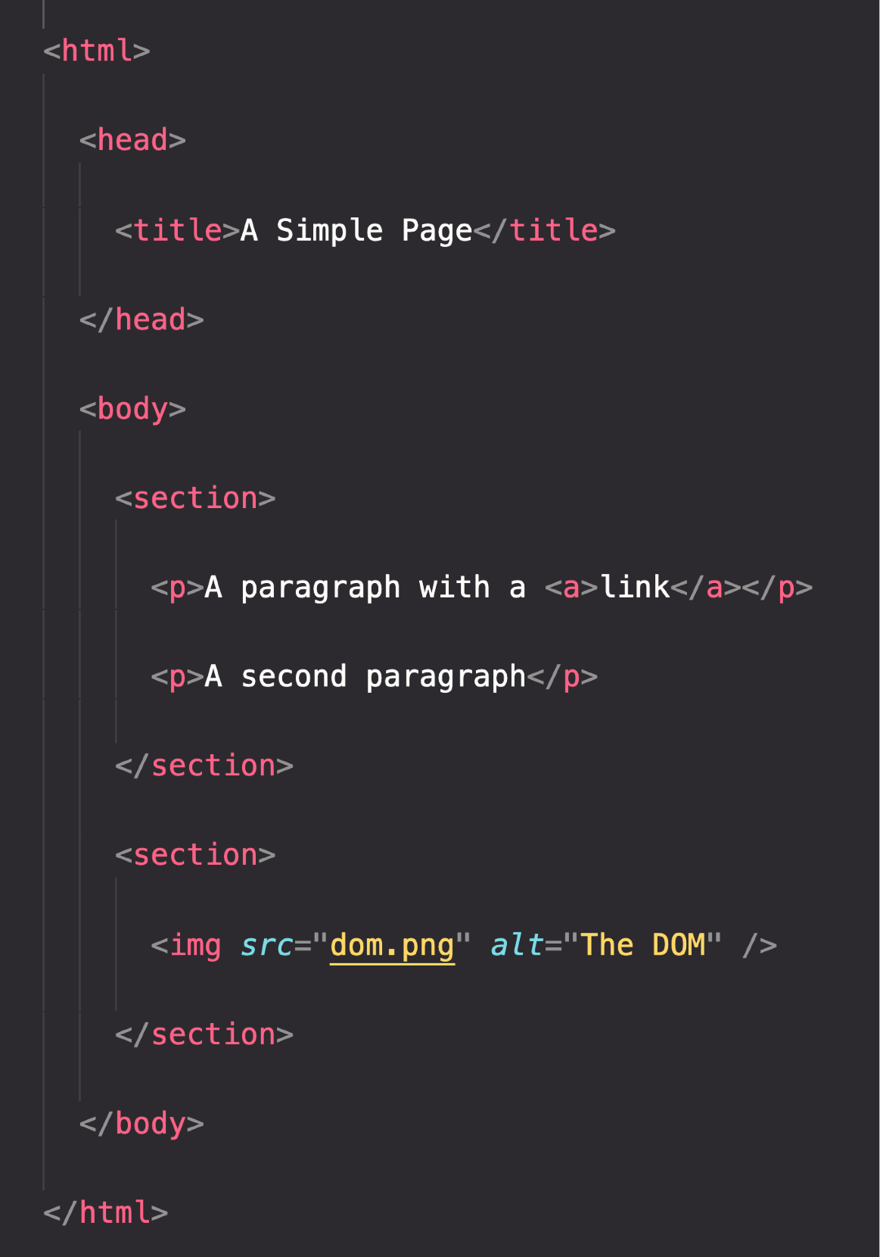

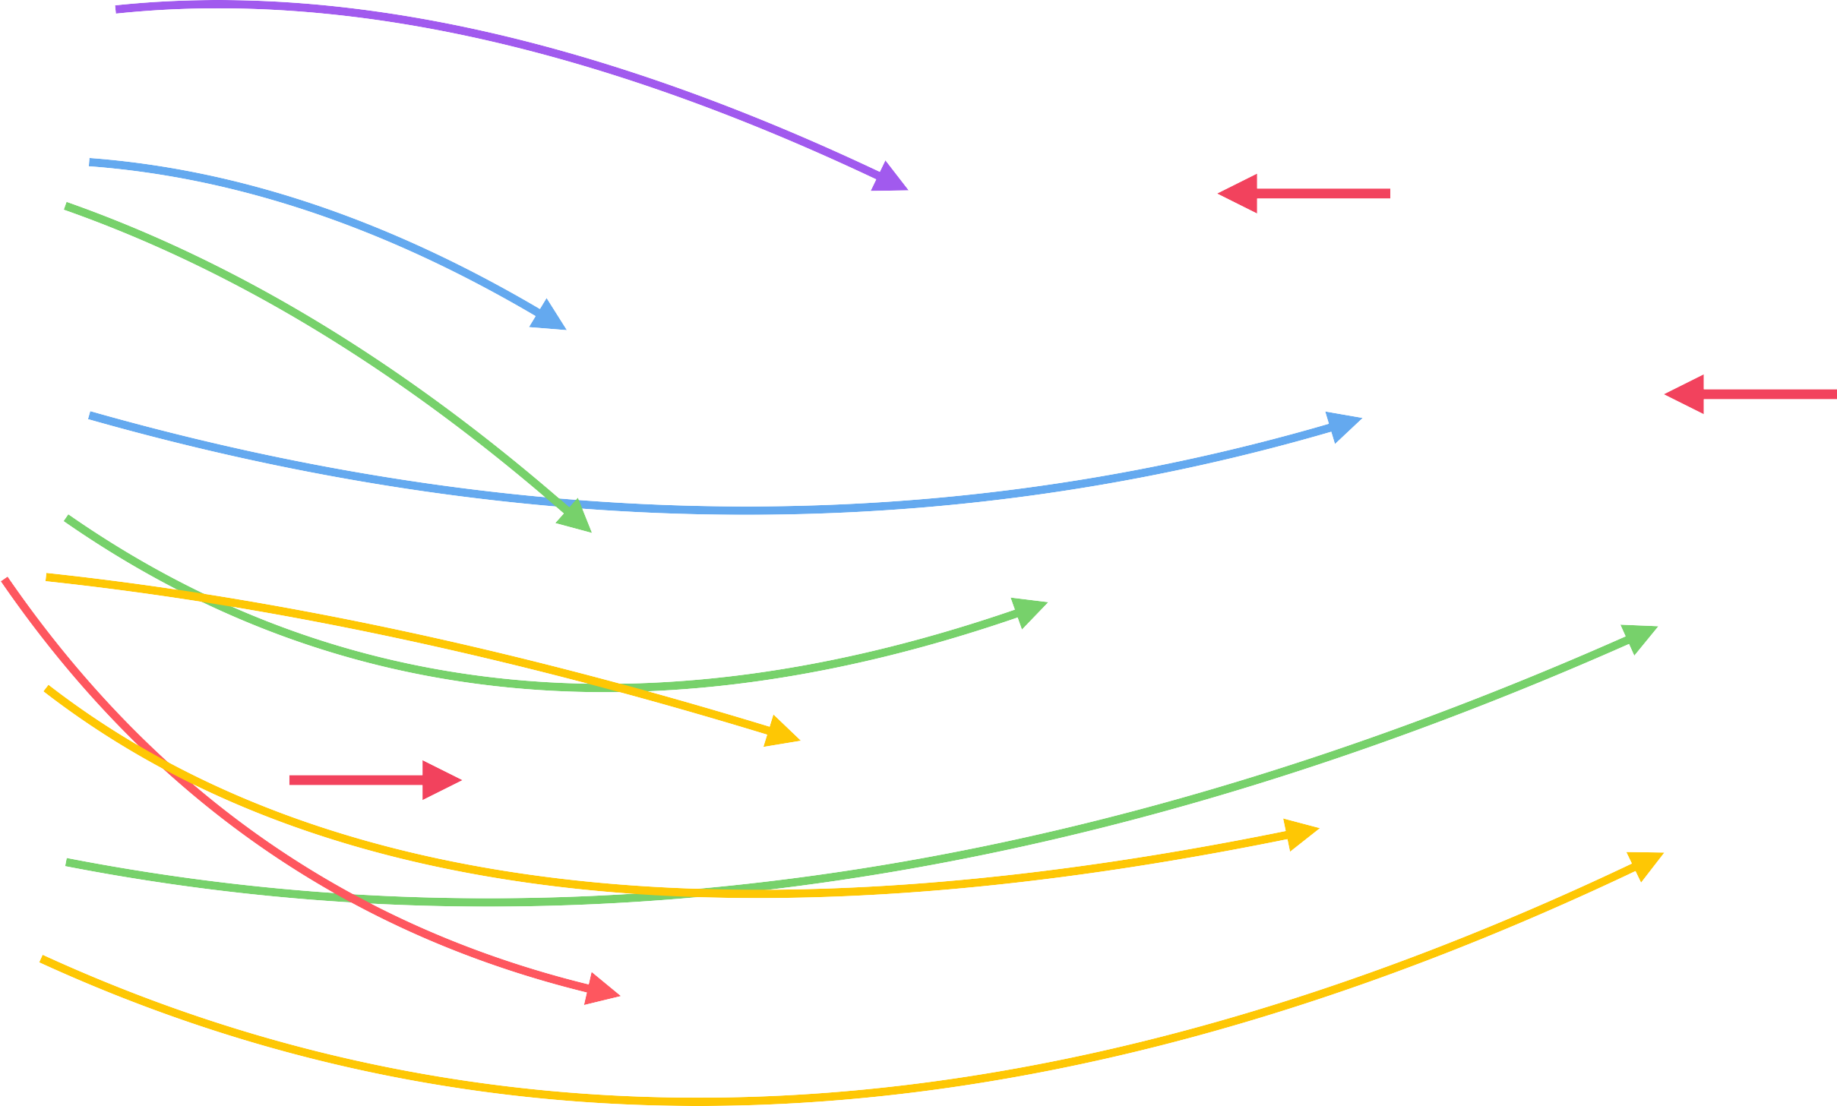
THE DOM TREE STRUCTURE
Special object that is the entry point to the DOM. Example: document.querySelector()

Slide 53

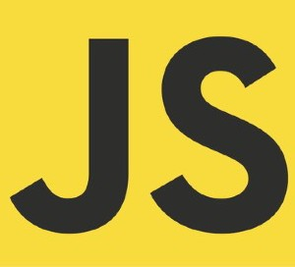




DOM ! ==JAVASCRIPT
DOM Methods and Properties for DOM Manipulation
NOT PART OF
For example
document.querySelector()
API: Application Programming Interface
WEB APIs
DOM Methods and Properties
Timers
CAN INTERACT WITH
Fetch

Slide 54
HOW JAVASCRIPT WORKS BEHIND THE
SCENES

Slide 55
SECTION
HOW JAVASCRIPT WORKS BEHIND THE SCENES
LECTURE
AN HIGH-LEVEL OVERVIEW OF JAVASCRIPT

Slide 56
WHAT IS JAVASCRIPT: REVISITED
JAVASCRIPT
JAVASCRIPT IS A HIGH-LEVEL, OBJECT-ORIENTED, MULTI-PARADIGM PROGRAMMING LANGUAGE.

Slide 57
WHAT IS JAVASCRIPT: REVISITED
FIRST-CLASS FUNCTIONS
JAVASCRIPT
JAVASCRIPT IS A HIGH-LEVEL, PROTOTYPE-BASED OBJECT-ORIENTED, MULTI-PARADIGM, INTERPRETED OR JUST-IN-TIME COMPILED,
PROGRAMMING
DYNAMIC, SINGLE-THREADED,
AND A NON-BLOCKING
LANGUAGE WITH
EVENT LOOP CONCURRENCY MODEL.

Slide 58
DECONSTRUCTING THE MONSTER DEFINITION
High-level
Garbage-collected
Interpreted or just-in-time compiled
Multi-paradigm
Prototype-based object-oriented
First-class functions
Dynamic
Single-threaded
Non-blocking event loop

Slide 59


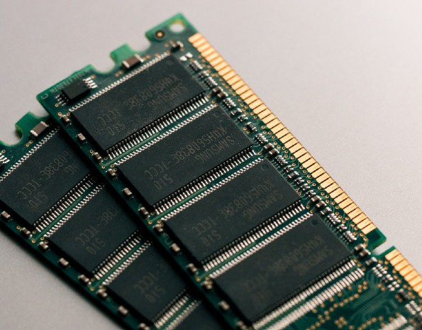
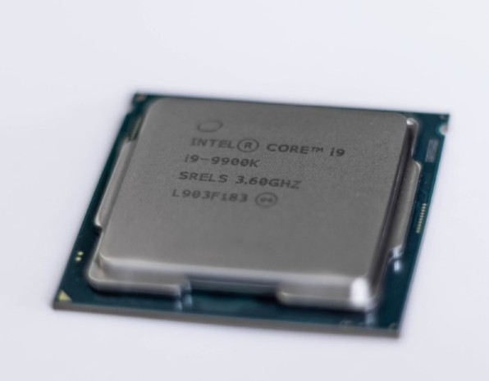


DECONSTRUCTING THE MONSTER DEFINITION
High-level
Any computer program needs resources:
Garbage-collected
Interpreted or just-in-time compiled
+
Multi-paradigm
Prototype-based object-oriented
First-class functions
Dynamic
LOW-LEVEL
HIGH-LEVEL
Single-threaded
Developer has to manage resources manually
Developer does NOT have to worry, everything happens automatically
Non-blocking event loop

Slide 60


DECONSTRUCTING THE MONSTER DEFINITION
High-level
Garbage-collected
Interpreted or just-in-time compiled
Multi-paradigm
Cleaning the memory so we don’t have to
Prototype-based object-oriented
First-class functions
Dynamic
Single-threaded
Non-blocking event loop

Slide 61

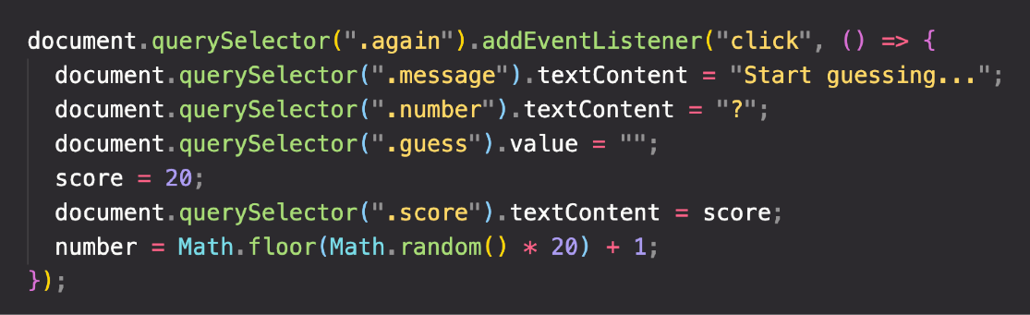


DECONSTRUCTING THE MONSTER DEFINITION
High-level
Garbage-collected
Abstraction over 0s and 1s
Interpreted or just-in-time compiled
Multi-paradigm
CONVERT TO MACHINE CODE = COMPILING
Prototype-based object-oriented
Happens inside the JavaScript engine
First-class functions
Dynamic
Single-threaded
More about this Later in this Section
Non-blocking event loop

Slide 62

DECONSTRUCTING THE MONSTER DEFINITION
High-level
Paradigm: An approach and mindset of structuring code, which will direct your coding style and technique.
Garbage-collected
Interpreted or just-in-time compiled
The one we’ve been using so far
Multi-paradigm
1 ^{Procedural programming}
Imperative vs.
Declarative
2
Object-oriented programming (OOP)
Prototype-based object-oriented
3
Functional programming (FP)
First-class functions
Dynamic
Single-threaded
More about this later in Multiple Sections
Non-blocking event loop

Slide 63
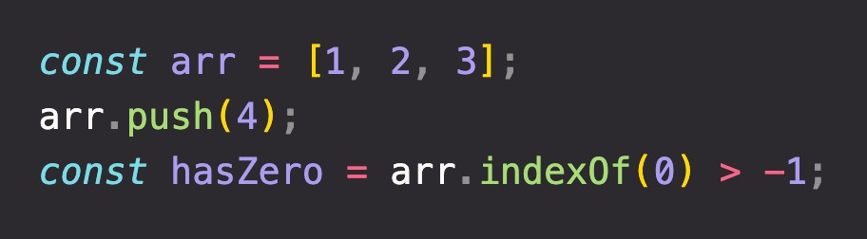
DECONSTRUCTING THE MONSTER DEFINITION
High-level
Prototype
Garbage-collected
Array
Array.prototype.push
(Oversimplification!)
Interpreted or just-in-time compiled
Array.prototype.indexOf
Multi-paradigm
Our array inherits methods from prototype
Built from prototype
Prototype-based object-oriented
First-class functions
Dynamic
Single-threaded
More about this in Section Object Oriented Programming
Non-blocking event loop

Slide 64

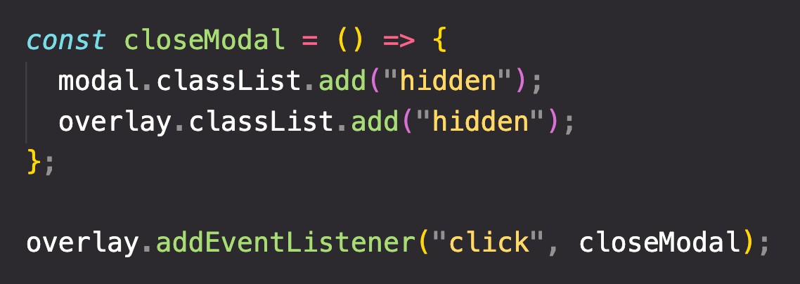
DECONSTRUCTING THE MONSTER DEFINITION
High-level
In a language with first-class functions, functions are simply treated as variables. We can pass them into other functions, and return them from functions.
Garbage-collected
Interpreted or just-in-time compiled
Multi-paradigm
Passing a function into another function as an argument:
First-class functions!
Prototype-based object-oriented
First-class functions
Dynamic
Single-threaded
More about this in Section A Closer Look at Functions
Non-blocking event loop

Slide 65

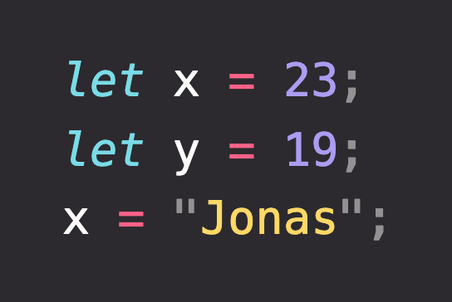



DECONSTRUCTING THE MONSTER DEFINITION
High-level
Garbage-collected
Dynamically-typed language:
Interpreted or just-in-time compiled
No data type definitions. Types becomes known at runtime
Multi-paradigm
Prototype-based object-oriented
Data type of variable is automatically changed
First-class functions
Dynamic
Single-threaded
Non-blocking event loop

Slide 66
DECONSTRUCTING THE MONSTER DEFINITION
High-level
Concurrency model: how the JavaScript engine handles multiple tasks happening at the same time.
Garbage-collected
Why do we need that?
Interpreted or just-in-time compiled
JavaScript runs in one single thread, so it can only do one thing at a time.
Multi-paradigm
So what about a long-running task?
Prototype-based object-oriented
Sounds like it would block the single thread. However, we want non-blocking behavior!
First-class functions
How do we achieve that?
(Oversimplification!)
Dynamic
By using an event loop: takes long running tasks, executes them in the “background”, and puts them back in the main thread once they are finished.
Single-threaded
More about this Later in this Section
Non-blocking event loop

Slide 67
SECTION
HOW JAVASCRIPT WORKS BEHIND THE SCENES
LECTURE
THE JAVASCRIPT ENGINE AND RUNTIME

Slide 68



WHAT IS A JAVASCRIPT ENGINE?
JS ENGINE
ENGINE
PROGRAM THAT EXECUTES
JAVASCRIPT CODE.
Object in memory
Execution context
Example: V8 Engine
CALL STACK
HEAP
How is it compiled?
Where our code is executed
Where objects are stored

Slide 69


COMPUTER SCIENCE SIDENOTE: COMPILATION VS. INTERPRETATION
Compilation: Entire code is converted into machine code at once, and written to a binary file that can be executed by a computer.
Source code
STEP 1
Portable file:
machine code
STEP 2
Program running
COMPILATION
EXECUTION
Can happen way after compilation
Interpretation: Interpreter runs through the source code and executes it line by line.
Source code
STEP 1
Program running
EXECUTION LINE BY LINE
Code still needs to be converted to machine code
Just-in-time (JIT) compilation: Entire code is converted into machine code at once, then executed immediately.
Source code
STEP 1
Machine code
STEP 2
Program running
COMPILATION
EXECUTION
NOT a portable file
Happens immediately

Slide 70
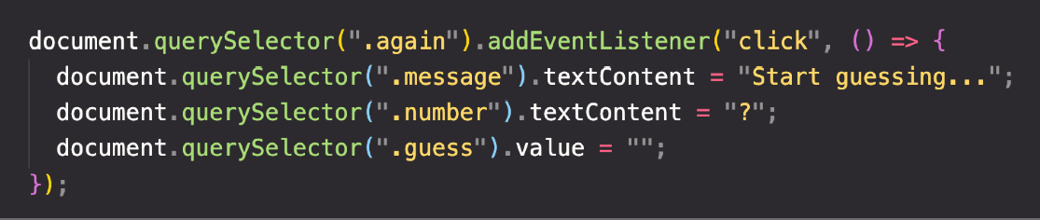
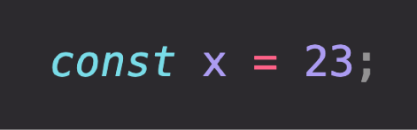
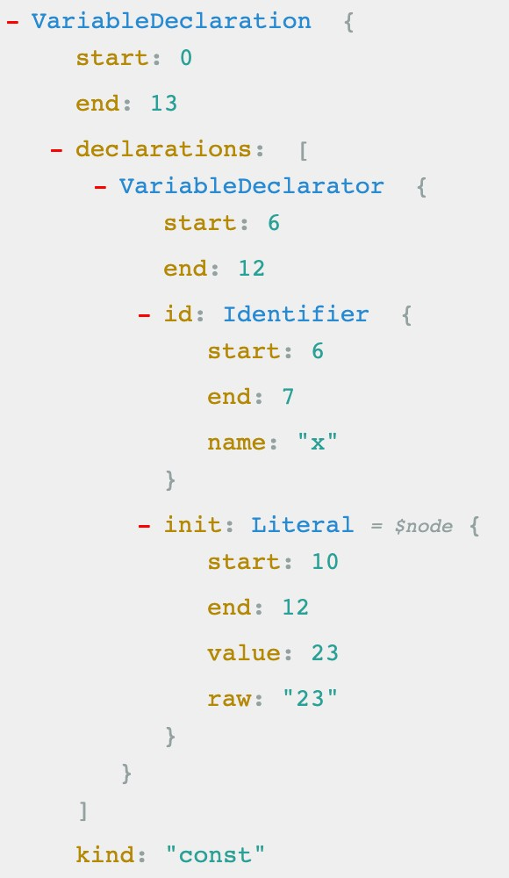




MODERN JUST-IN-TIME COMPILATION OF JAVASCRIPT
“JavaScript is an interpreted language”
ENGINE
AST Example
Happens in special threads that we can’t access from code
Parsing
Examp^{le}
AST
Compilation
Just-in-time compilation
Optimization
Execution
Happens in Call Stack
During execution!

Slide 71


THE BIGGER PICTURE: JAVASCRIPT RUNTIME
RUNTIME IN THE BROWSER
Functionalities provided to
Container including all the things
the engine, accessible on
ENGINE
window object
(in this case in the browser)
DOM
Timers
...
Fetch API
EVENT LOOP
Essential for non-blocking concurrency model
CALLBACK QUEUE
click
timer
data
...
onClick
HEAP
CALL STACK
Example: Callback function from DOM event listener

Slide 72
THE BIGGER PICTURE: JAVASCRIPT RUNTIME
RUNTIME IN NODE.JS
WEB APIs
C++ BINDINGS & THREAD POOL
ENGINE
EVENT LOOP
CALLBACK QUEUE
click
timer
data
...
HEAP
CALL STACK

Slide 73
SECTION
HOW JAVASCRIPT WORKS BEHIND THE SCENES
LECTURE
EXECUTION CONTEXTS AND THE CALL STACK

Slide 74

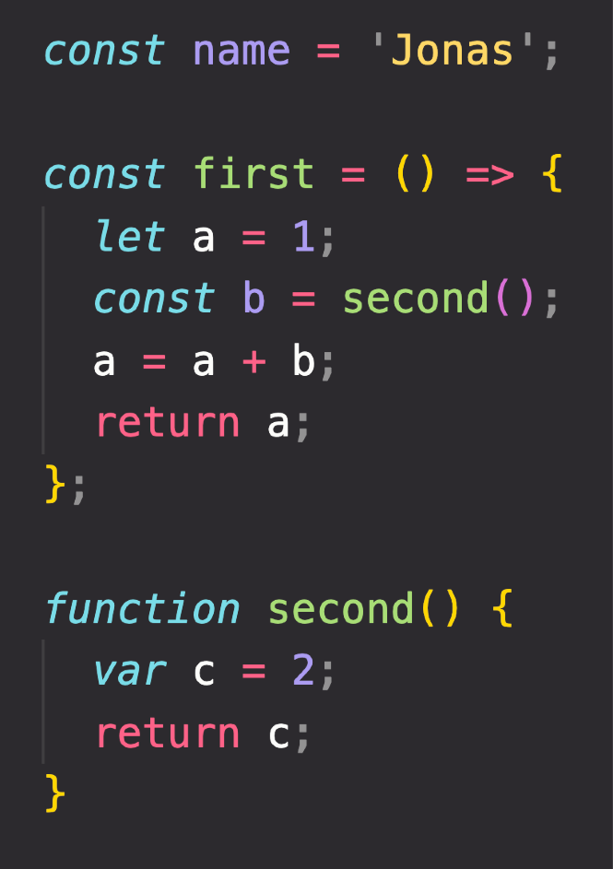



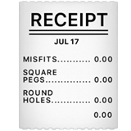


WHAT IS AN EXECUTION CONTEXT?
Compilation
EXECUTION CONTEXT
Human-readable code:
Environment in which a piece of JavaScript is executed. Stores all the necessary information for some code to be executed. JavaScript code"
Creation of global execution context (for top-level code)
NOT inside a function
+ +
Execution of top-level code
(inside global EC)
Pizza “execution context”
EXECUTION
Exactly one global execution context (EC): Default context, created for code that is not inside any function (top-level).
Function body only executed when called!
Execution of functions and waiting for callbacks
One execution context per function: For each function call, a new execution context is created.
All together make the call stack
Example: click event callback

Slide 75
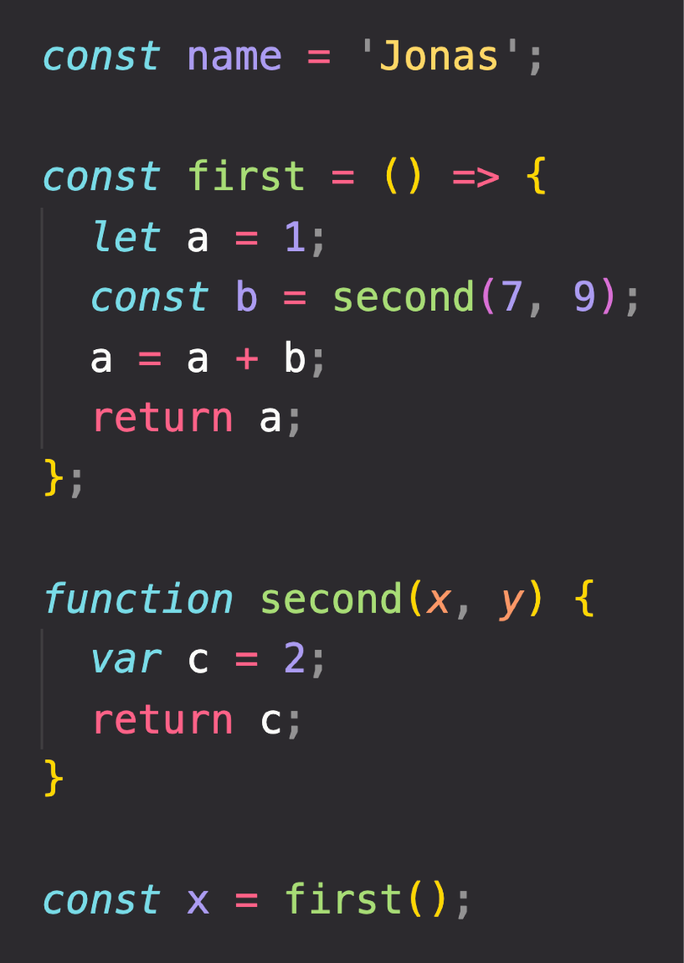
EXECUTION CONTEXT IN DETAIL
Global
Literally the function code
WHAT’S INSIDE EXECUTION CONTEXT?
name = ‘Jonas’
first = <function>
second = <function>
x = <unknown>
1
Variable Environment
let, const and var declarations Functions
arguments object
Need to run
first() first
first()
a = 1
b = <unknown>
Need to run
second() first
2
Scope chain
NOT in arrow functions!
3
this keyword
second()
c = 2
arguments = [7, 9]
Generated during “creation phase”, right before execution
Array of passed arguments. Available in all “regular” functions (not arrow)
(Technically, values only become known during execution)

Slide 76
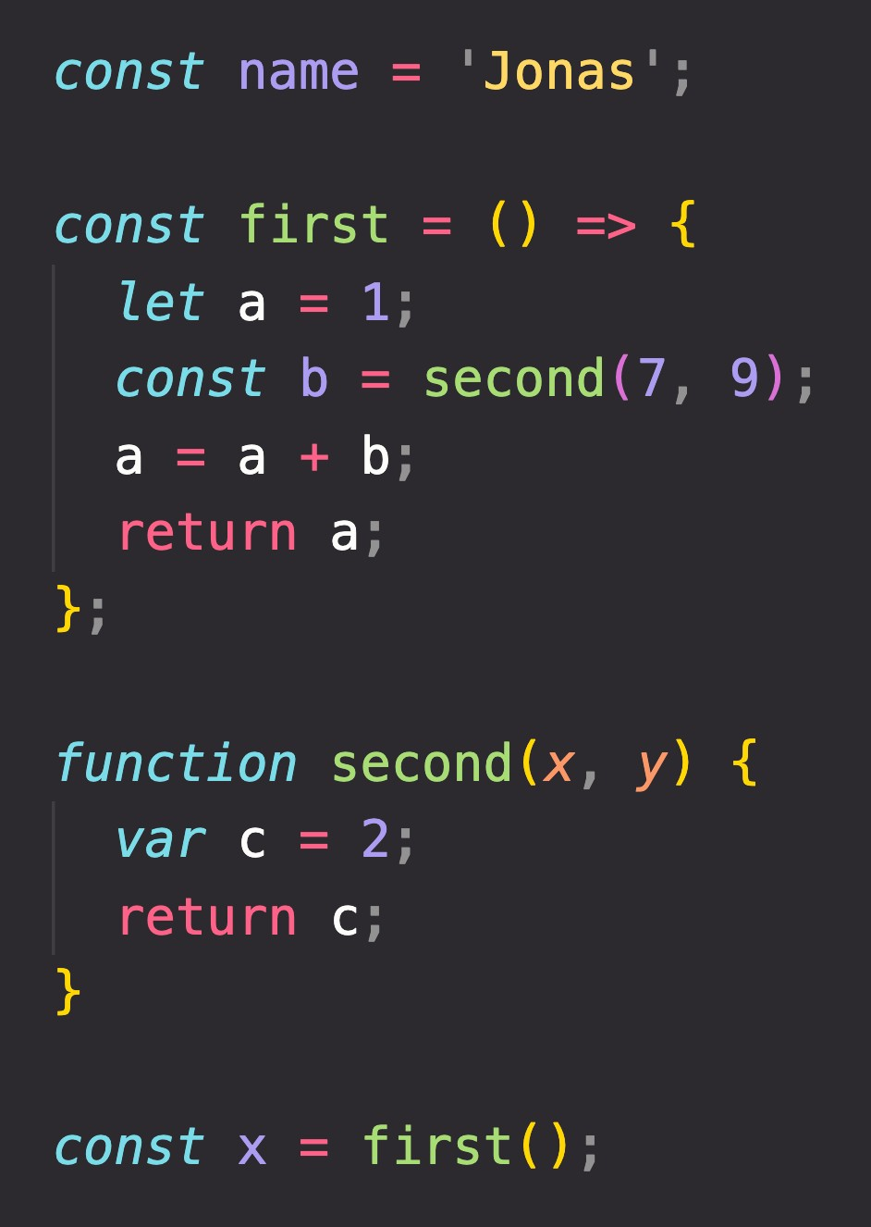


THE CALL STACK
Compiled code starts execution
second()
first()
ENGINE
Global
“Place” where execution contexts get
CALL STACK
stacked on top of each other, to keep
track of where we are in the execution

Slide 77
SECTION
HOW JAVASCRIPT WORKS BEHIND THE SCENES
LECTURE
SCOPE AND THE SCOPE CHAIN

Slide 78



SCOPING AND SCOPE IN JAVASCRIPT: CONCEPTS
EXECUTION CONTEXT
Variable environment
this keyword
Scope chain
SCOPE CONCEPTS
Scoping: How our program’s variables are organized and accessed. “Where do variables live?” or “Where can we access a certain variable, and where not?”;
Lexical scoping: Scoping is controlled by placement of functions and blocks in the code;
Scope: Space or environment in which a certain variable is declared (variable environment in case of functions). There is global scope, function scope, and block scope;
Scope of a variable: Region of our code where a certain variable can be accessed.

Slide 79
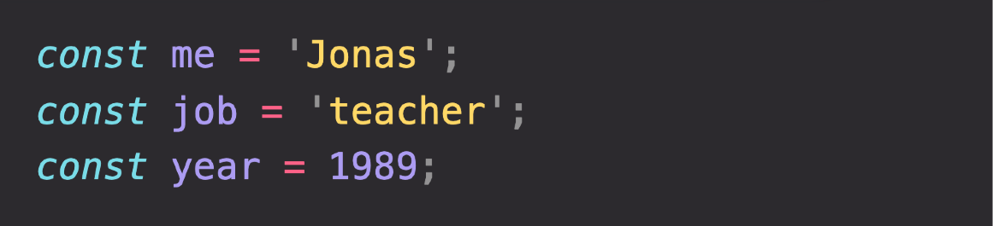
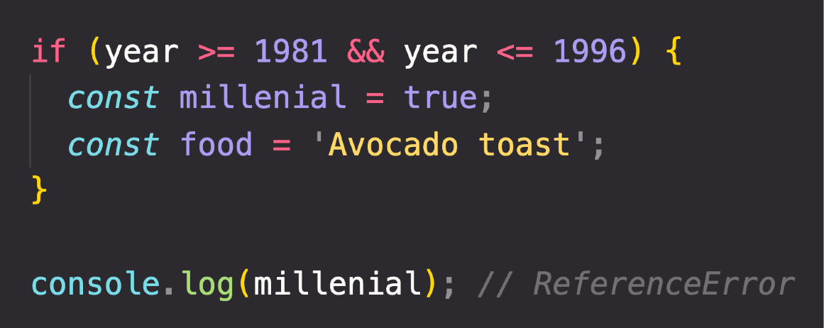

THE 3 TYPES OF SCOPE
FUNCTION SCOPE
Variables are accessible only
inside function, NOT outside
Also called local scope
GLOBAL SCOPE
BLOCK SCOPE (ES6)
Example: if block, for loop block, etc.
Outside of any function or block
Variables declared in global scope are accessible everywhere
Variables are accessible only
inside block (block scoped)
HOWEVER, this only applies to
let and const variables!
Functions are also block scoped
(only in strict mode)

Slide 80
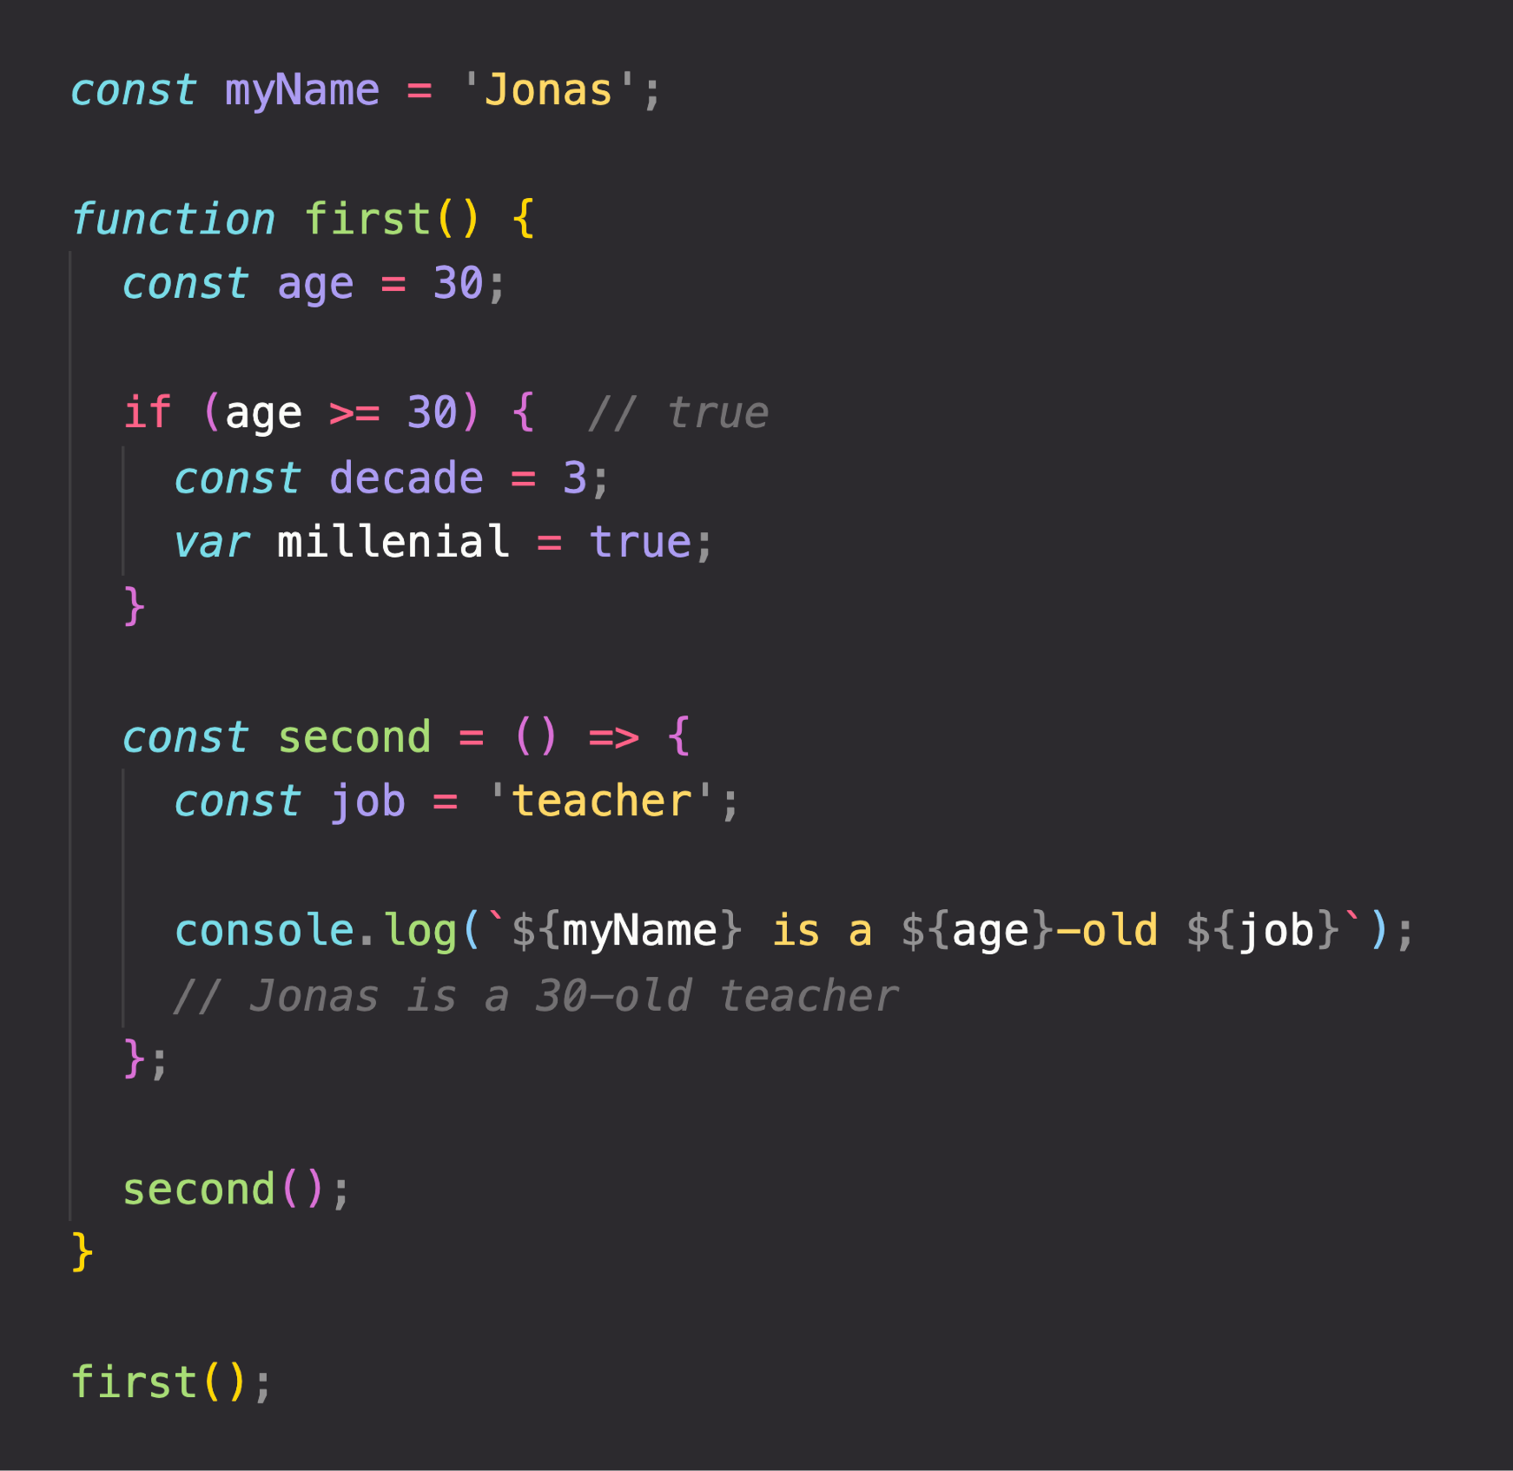


THE SCOPE CHAIN
(Considering only variable declarations)
Global scope
Global variable
myName = “Jonas”
CHAIN
SCOPE CHAIN
let and const are block-scoped
SCOPE
first() scope
Variables not in current scope
age = 30
millennial = true
var is function-scoped
IN
myName = “Jonas”
Scope has access to variables from all outer scopes
LOOKUP
if block scope
second() scope
decade = 3
job = “teacher”
VARIABLE
age = 30
millennial = true
age = 30
millennial = true
myName = “Jonas”
myName = “Jonas”
Notes:
https://viblo.asia/p/phan-biet-kieu-bien-var-let-va-const-trong-javascript-ORNZqaOnZ0n

Slide 81
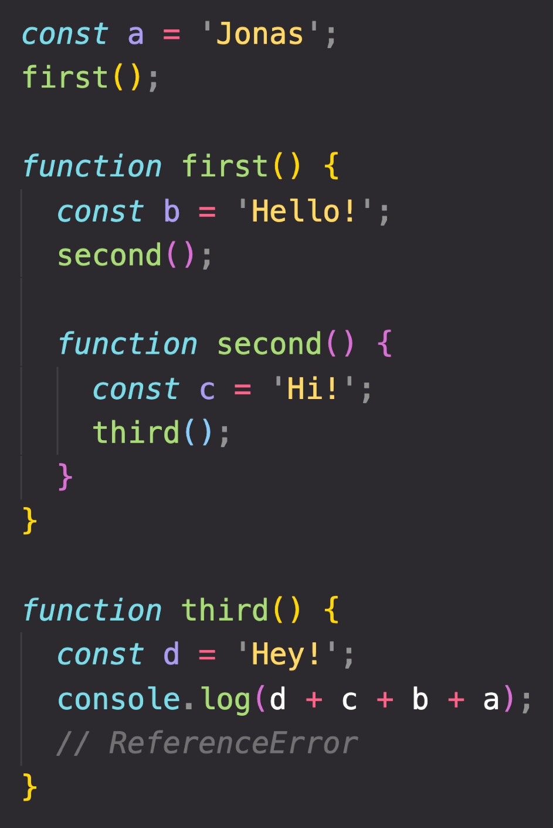
SCOPE CHAIN VS. CALL STACK
Global scope
a = “Jonas”
first = <function>
third = <function>
third() EC
d = “Hey!”
second() EC
first() scope
b = “Hello!” second = <function>
a = “Jonas” first = <function> third = <function>
third() scope
d = “Hey!”
a = “Jonas” first = <function> third = <function>
c = “Hi!”
first() EC
b = “Hello!”
second = <function>
SCOPE CHAIN
Order in which functions are written in the code
Global EC
second() scope
c = “Hi!”
b = “Hello!” second = <function>
a = “Jonas” first = <function> third = <function>
a = “Jonas”
first = <function>
third = <function>
CALL STACK
Order in which functions were called
Has nothing to do with order in which functions were called!
c and b can NOT be found in third() scope!
Variable environment (VE)

Slide 82
SUMMARY
Scoping asks the question “Where do variables live?” or “Where can we access a certain variable, and where not?”;
There are 3 types of scope in JavaScript: the global scope, scopes defined by functions, and scopes defined by blocks; Only let and const variables are block-scoped. Variables declared with var end up in the closest function scope;
In JavaScript, we have lexical scoping, so the rules of where we can access variables are based on exactly where in the code functions and blocks are written;
Every scope always has access to all the variables from all its outer scopes. This is the scope chain!
When a variable is not in the current scope, the engine looks up in the scope chain until it finds the variable it’s looking for. This is called variable lookup;
The scope chain is a one-way street: a scope will never, ever have access to the variables of an inner scope;
The scope chain in a certain scope is equal to adding together all the variable environments of the all parent scopes;
The scope chain has nothing to do with the order in which functions were called. It does not affect the scope chain at all!

Slide 83
SECTION
HOW JAVASCRIPT WORKS BEHIND THE SCENES
LECTURE
VARIABLE ENVIRONMENT: HOISTING AND THE TDZ

Slide 84


HOISTING IN JAVASCRIPT
Hoisting: Makes some types of variables accessible/usable in the code before they are actually declared. “Variables lifted to the top of their scope”.
EXECUTION CONTEXT
Scope chain
this keyword
Variable environment
BEHIND THE SCENES
Before execution, code is scanned for variable declarations, and for each variable, a new property is created in the variable environment object.
HOISTED?
INITIAL VALUE
SCOPE
In strict mode.
Otherwise: function!
function declarations
YES
Actual function
Block
var variables
YES
undefined
Function
Technically, yes. But not in practice
let and const variables
NO
<uninitialized>, TDZ
Block
function expressions and arrows
Depends if using var or let/const
Temporal Dead Zone

Slide 85
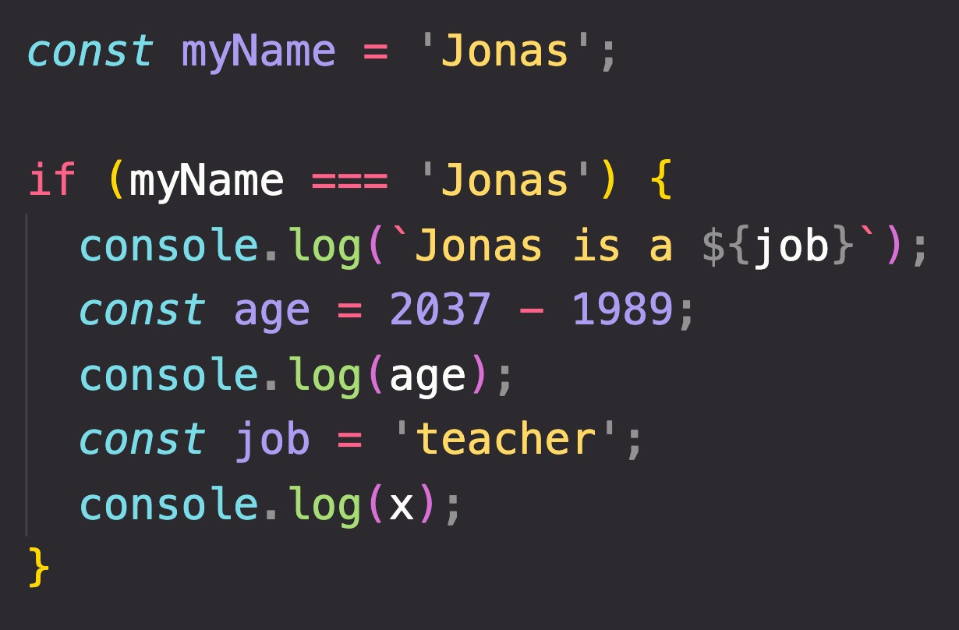
TEMPORAL DEAD ZONE, LET AND CONST
TEMPORAL DEAD ZONE FOR job VARIABLE
Different kinds of error messages:
ReferenceError: Cannot access 'job' before initialization ReferenceError: x is not defined
WHY HOISTING?
WHY TDZ?
Using functions before actual declaration;
var hoisting is just a by product.
Makes it easier to avoid and catch errors: accessing variables before declaration is bad practice and should be avoided;
Makes const variables actually work

Slide 86
SECTION
HOW JAVASCRIPT WORKS BEHIND THE SCENES
LECTURE
THE THIS KEYWORD

Slide 87
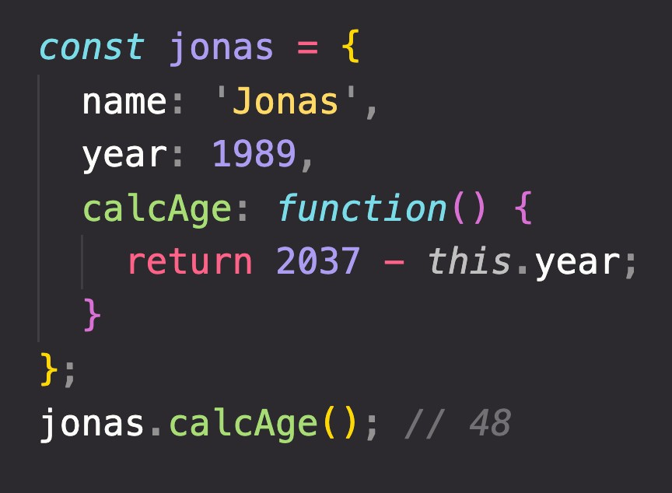
HOW THE THIS KEYWORD WORKS
this keyword/variable: Special variable that is created for every execution context (every function). Takes the value of (points to) the “owner” of the function in which the this keyword is used.
EXECUTION CONTEXT
Variable environment Scope chain
this is NOT static. It depends on how the function is called, and its value is only assigned when the function is actually called.
this keyword
Method example:
Method this = <Object that is calling the method>
Simple function call this = undefined
In strict mode! Otherwise:
window (in the browser)
Don’t get own this
Arrow functions this = <this of surrounding function (lexical this)>
Event listener this = <DOM element that the handler is attached to>
new, call, apply, bind <Later in the course... >
calcAge
is method
jonas
1989
this does NOT point to the function itself, and also NOT the its variable environment!
Way better than using
jonas.year!

Slide 88
GOT QUESTIONS? FEEDBACK?

Slide 89
SECTION
HOW JAVASCRIPT WORKS BEHIND THE SCENES
LECTURE
PRIMITIVES VS. OBJECTS (PRIMITIVE VS. REFERENCE TYPES)

Slide 90
REVIEW: PRIMITIVES, OBJECTS AND THE JAVASCRIPT ENGINE
PRIMITIVES
Number String Boolean Undefined Null Symbol BigInt
OBJECTS
Object literal Arrays Functions Many more…
ENGINE
STORED IN
STORED IN
REFERENCE TYPES
CALL STACK
HEAP
PRIMITIVE TYPES

Slide 91
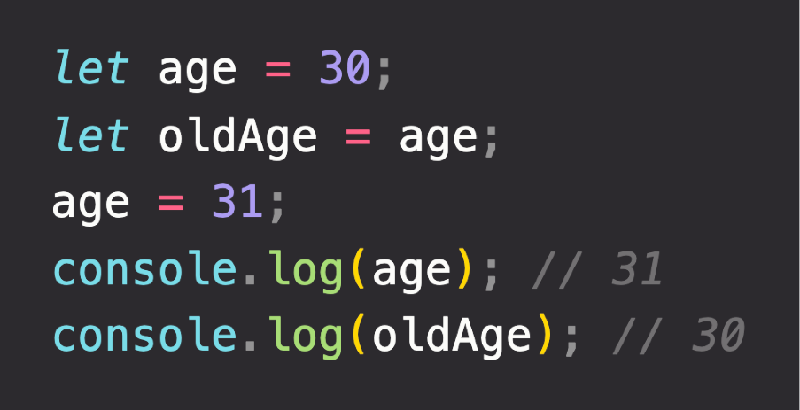


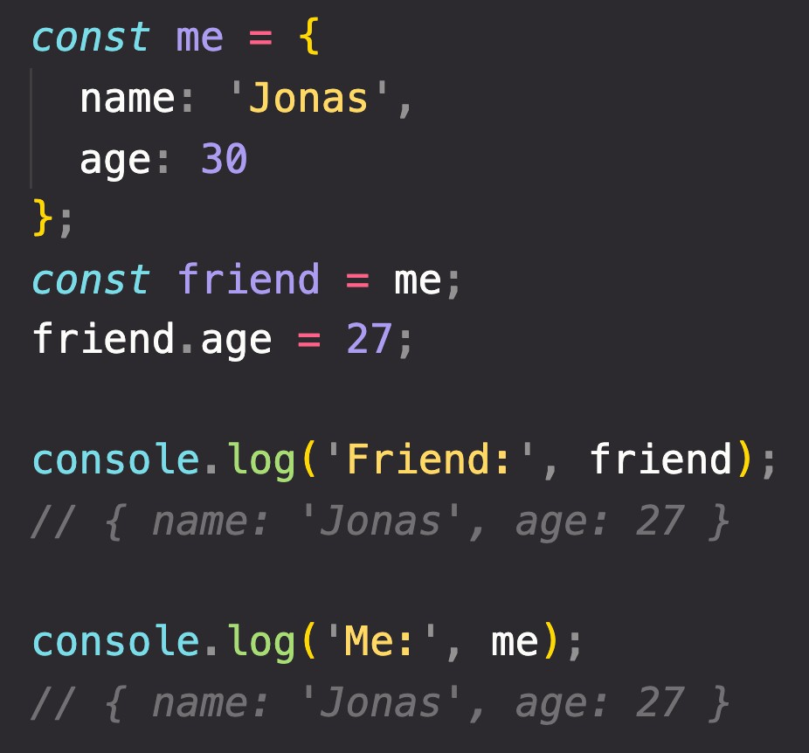
PRIMITIVE VS. REFERENCE VALUES
Primitive values example:
Identifier
Address
Value
Address
Value
age
0001
30 31
{
name: ‘Jonas’; age: 30;
}
D30F
Reference values example:
oldAge
0002
31
Reference to memory address in Heap
27
No problem, because we’re NOT changing the value at address 0003!
me
0003
D30F
friend
CALL STACK
HEAP

Slide 92
“HOW JAVASCRIPT WORKS BEHIND THE SCENES” TOPICS FOR LATER...
1
Prototypal Inheritance
Object Oriented Programming (OOP) With JavaScript
2
Event Loop
Asynchronous JavaScript: Promises, Async/Await and AJAX
3
How the DOM Really Works
Advanced DOM and Events

Slide 93
DATA STRUCTURES, MODERN OPERATORS AND STRINGS

Slide 94
SECTION
DATA STRUCTURES, MODERN OPERATORS AND STRINGS
LECTURE
SUMMARY: WHICH DATA STRUCTURE TO USE?

Slide 95
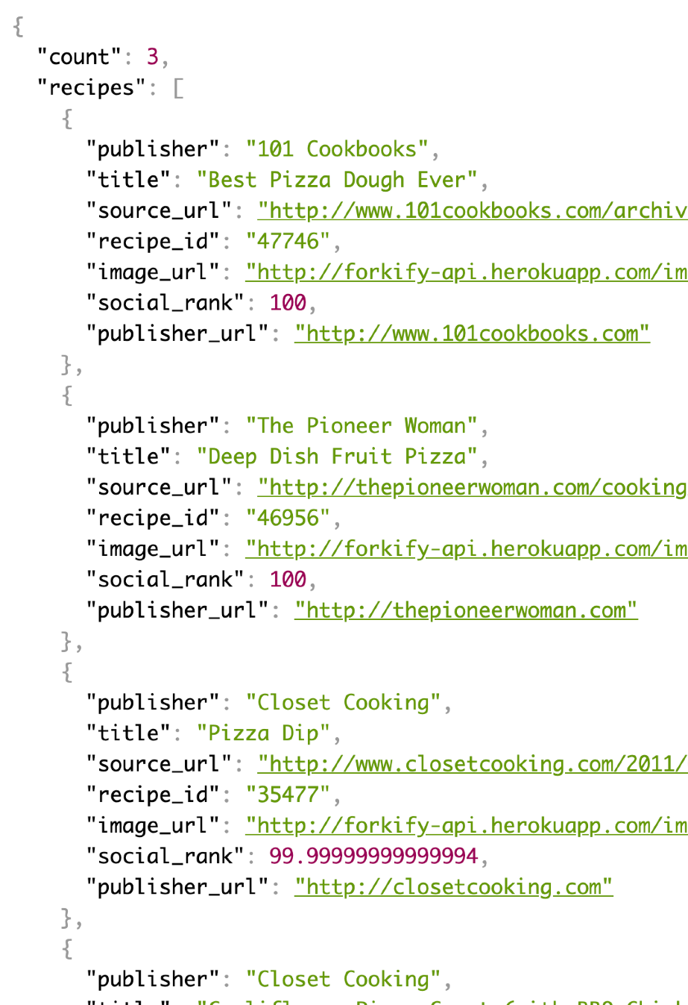
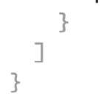

DATA STRUCTURES OVERVIEW
SOURCES OF DATA
From the program itself: Data written directly in source code (e.g. status messages)
From the UI: Data input from the user or data written in DOM (e.g tasks in todo app)
From external sources: Data fetched for example from web API (e.g. recipe objects)
“Object”
Array
Application Programming Interface
“Object”
Collection of data
OTHER BUILT-IN:
WeakMap WeakSet
NON-BUILT IN:
Stacks Queues Linked lists Trees
Hash tables
Data structure
SIMPLE LIST?
KEY/VALUE PAIRS?
Arrays or Sets
Objects or Maps
Keys allow us to
describe values
JSON data format example

Slide 96

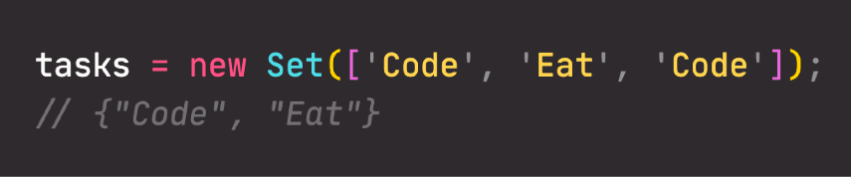


ARRAYS VS. SETS AND OBJECTS VS. MAPS
ARRAYS
VS.
SETS
OBJECTS
VS.
MAPS
Use when you need ordered list of values (might contain duplicates)
Use when you need to
manipulate data
Use when you need to work with unique values
Use when high-performance
is really important
Use to remove duplicates
from arrays
More “traditional” key/value store (“abused” objects)
Easier to write and access values with . and []
Better performance
Keys can have any data type Easy to iterate
Easy to compute size
Use when you need to include functions (methods)
Use when working with JSON (can convert to map)
Use when you simply need to map key to values
Use when you need keys that are not strings

Slide 97
A CLOSER LOOK AT FUNCTIONS

Slide 98
SECTION
A CLOSER LOOK AT FUNCTIONS
LECTURE
FIRST-CLASS AND HIGHER-ORDER FUNCTIONS

Slide 99





FIRST-CLASS VS. HIGHER-ORDER FUNCTIONS
FIRST-CLASS FUNCTIONS
HIGHER-ORDER FUNCTIONS
JavaScript treats functions as first-class citizens
This means that functions are simply values
Functions are just another “type” of object
Store functions in variables or properties:
A function that receives another function as an argument, that returns a new function, or both
This is only possible because of first-class functions
Function that receives another function
1
Higher-order function
Callback function
Pass functions as arguments to OTHER functions:
2
Function that returns new function
Higher-order function
Returned function
Return functions FROM functions
Call methods on functions:

Slide 100
SECTION
A CLOSER LOOK AT FUNCTIONS
LECTURE
CLOSURES

Slide 101

“CREATING” A CLOSURE
Global scope
secureBooking = <f>
booker = <f>
Variable Environment
secureBooking() scope
passengerCount = 0
secureBooking = <f> booker = <f>
secureBooking() EC
passengerCount = 0
Global EC
secureBooking = <f>
booker = <f>
CALL STACK
Order in which functions were called
Order in which functions are written in the code
SCOPE CHAIN

Slide 102


UNDERSTANDING CLOSURES
secureBooking() EC
Variable Environment of Execution Context in which booker was created
Global scope
passengerCount = 0
passengerCount = 0
secureBooking = <f>
booker = <f>
secureBooking() scope
passengerCount = 0
secureBooking = <f> booker = <f>
booker() EC
<empty>
This is the function
booker() scope
<empty>
secureBooking = <f> booker = <f>
Global EC
secureBooking = <f>
booker = <f>
CALL STACK
How to access
passengerCount?
SCOPE CHAIN

Slide 103
UNDERSTANDING CLOSURES
A function has access to the variable environment (VE) of the execution context in which it was created
Closure: VE attached to the function, exactly as it was at the time and place the function was created
Global scope
secureBooking = <f>
booker = <f>
secureBooking() scope
passengerCount = 0
secureBooking = <f> booker = <f>
booker() EC
(Priority over scope chain)
CLOSURE
<empty>
This is the function
booker() scope
<empty>
secureBooking = <f> booker = <f>
Global EC
01
secureBooking = <f>
booker = <f>
passengerCount = 2
CALL STACK
How to access
passengerCount?
SCOPE CHAIN

Slide 104


CLOSURES SUMMARY
A closure is the closed-over variable environment of the execution context in which a function was created, even after that execution context is gone;
Less formal
A closure gives a function access to all the variables of its parent function, even after that parent function has returned. The function keeps a reference to its outer scope, which preserves the scope chain throughout time.
Less formal
A closure makes sure that a function doesn’t loose connection to variables that existed at the function’s birth place;
Less formal
Function Connection Parent scope Variables
A closure is like a backpack that a function carries around wherever it goes. This backpack has all the variables that were present in the environment where the function was created.
Function
Closure
Variables
We do NOT have to manually create closures, this is a JavaScript feature that happens automatically. We can’t even access closed-over variables explicitly. A closure is NOT a tangible JavaScript object.

Slide 105
WORKING WITH ARRAYS

Slide 106
SECTION
WORKING WITH ARRAYS
LECTURE
DATA TRANSFORMATIONS: MAP, FILTER, REDUCE

Slide 107
DATA TRANSFORMATIONS WITH MAP, FILTER AND REDUCE
Original array
3
1
4
3
2
3
1
4
3
2
3
1
4
3
2
MAP
FILTER
REDUCE
current * 2
Example
current > 2
Accumulator
acc + current
1
2
6
2
8
6
4
3
4
3
13
11
348
Reduced value
Filtered array
map returns a new array containing the results of applying an operation on all original array elements
filter returns a new array containing the array elements that passed a specified test condition
reduce boils (“reduces”) all array elements down to one single value (e.g. adding all elements together)

Slide 108
SECTION
WORKING WITH ARRAYS
LECTURE
SUMMARY: WHICH ARRAY METHOD TO USE?

Slide 109


WHICH ARRAY METHOD TO USE?
“I WANT...:”
To mutate original array
Add to original:
A new array
An array index
Know if array includes
To transform to value
Computed from original:
Based on value:
Based on value:
Based on accumulator:
.push
(end)
.map
(loop)
.indexOf
.includes
.reduce
.unshift
(start)
(Boil down array to single value of any type: number, string, boolean, or even new array or object)
Filtered using condition:
Based on test condition:
Based on test condition:
.filter
.findIndex
.some
Remove from original:
.pop
(end)
.every
Portion of original:
.shift
(start)
.slice
.splice
(any)
An array element
Based on test condition:
A new string
Based on separator string:
To just loop array
Based on callback:
Adding original to other:
Others:
.concat
.reverse
.find
.join
.forEach
Flattening the original:
.sort
(Does not create a new array, just loops over it)
.flat
.fill
.flatMap

Slide 110
ADVANCED DOM AND EVENTS

Slide 111
SECTION
ADVANCED DOM AND EVENTS
LECTURE
HOW THE DOM REALLY WORKS

Slide 112


REVIEW: WHAT IS THE DOM?
BROWSER
DOM
INTERFACE
Allows us to make JavaScript interact with the browser;
Nodes
We can write JavaScript to create, modify and delete HTML elements; set styles, classes and attributes; and listen and respond to events;
DOM tree is generated from an HTML document, which we can then
interact with;
Application Programming Interface
DOM is a very complex API that contains lots of methods and properties to interact with the DOM tree
“Types” of DOM objects (next slide)
DOM tree
.querySelector() / .addEventListener() / .createElement() /
.innerHTML / .textContent / .children / etc ...

Slide 113

HOW THE DOM API IS ORGANIZED BEHIND THE SCENES
Represented by JavaScript object
.addEventListener()
.removeEventListener()
EventTarget
.innerHTML
.classList
.children
.parentElement
.append()
.remove()
.insertAdjacentHTML()
.querySelector()
.closest()
.matches()
.scrollIntoView()
.setAttribute()
.textContent
.childNodes
.parentNode
.cloneNode()
Node
Window
Global object, lots of methods and properties, many unrelated to DOM
INHERITANCE OF METHODS AND PROPERTIES
<p>Paragraph<p>
Element
Text
Comment
Document
Example:
Any HTMLElement will have access to
.addEventListener(),
.cloneNode()
or .closest() methods.
<p>Paragraph<p>
<!--Comment-->
.querySelector()
.createElement()
.getElementById()
HTMLElement
HTMLButtonElement
...
HTMLDivElement
(One different type of HTMLElement per HTML element...)
(THIS IS NOT A DOM TREE)

Slide 114
SECTION
ADVANCED DOM AND EVENTS
LECTURE
EVENT PROPAGATION: BUBBLING AND CAPTURING

Slide 115






BUBBLING AND CAPTURING
Click event
1
3
CAPTURING PHASE
BUBBLING PHASE
(THIS DOES NOT HAPPEN ON ALL EVENTS)
2
TARGET PHASE

Slide 116
SECTION
ADVANCED DOM AND EVENTS
LECTURE
EFFICIENT SCRIPT LOADING: DEFER AND ASYNC

Slide 117



DEFER AND ASYNC SCRIPT LOADING
HEAD
BODY END
REGULAR
Parsing HTML
Waiting...
Finish parsing HTML
Parsing HTML | Fetch script | Execute
DOMContentLoaded
Time
Fetch script
Execute
DOMContentLoaded
ASYNC
Parsing HTML
Waiting
Finish parsing HTML
Makes no sense
Fetch script
Execute
DOMContentLoaded
DEFER
Parsing HTML
Execute
Makes no sense
Fetch script
DOMContentLoaded

Slide 118
REGULAR VS. ASYNC VS. DEFER
END OF BODY
ASYNC IN HEAD
DEFER IN HEAD
Parse HTML | Fetch | Run
DOMContentLoaded
Parse HTML Wait
Fetch Run
Parse HTML
Parse HTML
Run
DOMContentLoaded
Fetch
DOMContentLoaded
Scripts are fetched and executed after the HTML is completely parsed
Use if you need to support old browsers
Scripts are fetched asynchronously and executed immediately
Usually the DOMContentLoaded event waits for all scripts to execute, except for async scripts. So, DOMContentLoaded does not wait for an async script
Scripts not guaranteed to execute in order
Use for 3rd-party scripts where order doesn’t matter (e.g. Google Analytics)
Scripts are fetched asynchronously and executed after the HTML is completely parsed
DOMContentLoaded event fires after
defer script is executed
Scripts are executed in order
This is overall the best solution! Use for your own scripts, and when order matters (e.g. including a library)
You can, of course, use different strategies for different scripts. Usually a complete web applications includes more than just one script
Parse HTML
Parse HTML
Fetch
Run
Fetch
Run
DOMContentLoaded
DOMContentLoaded

Slide 119
OBJECT ORIENTED
PROGRAMMING (OOP) WITH JAVASCRIPT

Slide 120
SECTION
OBJECT ORIENTED PROGRAMMING (OOP) WITH JAVASCRIPT
LECTURE
WHAT IS OBJECT-ORIENTED PROGRAMMING?

Slide 121



WHAT IS OBJECT-ORIENTED PROGRAMMING? (OOP)
Style of code, “how” we write and organize code
OOP
Objects may contain data (properties) and code (methods). By using objects, we pack data and the corresponding behavior into one block;
In OOP, objects are self-contained pieces/blocks of code;
Objects are building blocks of applications, and interact with one another; Interactions happen through a public interface (API): methods that the code
outside of the object can access and use to communicate with the object;
Object-oriented programming (OOP) is a programming paradigm based on the
concept of objects;
E.g. user or todo list item
Data
We use objects to model (describe) real-world or abstract features;
E.g. HTML component or data structure
Behaviour
OOP was developed with the goal of organizing code, to make it more flexible and easier to maintain (avoid “spaghetti code”).

Slide 122













CLASSES AND INSTANCES (TRADITIONAL OOP)
Conceptual overview: it works a bit differently in JavaScript. Still important to understand!
Like a blueprint from which we can create new objects
Instance
New object created from the class. Like a
real house created from an abstract blueprint
CLASS
Instance
Instance
Just a representation, NOT actual JavaScript syntax!
JavaScript does NOT support real classes like represented here

Slide 123

THE 4 FUNDAMENTAL OOP PRINCIPLES
The 4 fundamental principles of Object- Oriented Programming
Abstraction
Encapsulation
“How do we actually design classes? How do we model real-world data into classes?”
Inheritance
Polymorphism

Slide 124







PRINCIPLE 1: ABSTRACTION
Real phone
Abstracted phone
Abstraction
Encapsulation
Inheritance
Polymorphism
Details have been abstracted away
Do we really need all these low-level details?
Abstraction: Ignoring or hiding details that don’t matter, allowing us to get an overview perspective of the thing we’re implementing, instead of messing with details that don’t really matter to our implementation.

Slide 125


PRINCIPLE 2: ENCAPSULATION
Again, NOT actually JavaScript syntax (the private keyword doesn’t exist)
NOT accessible from
outside the class!
Abstraction
STILL accessible from
within the class!
WHY?
Encapsulation
STILL accessible from
within the class!
NOT accessible from
outside the class!
Prevents external code from accidentally manipulating internal properties/state
Inheritance
Allows to change internal implementation without the risk of breaking external code
Polymorphism
Encapsulation: Keeping properties and methods private inside the class, so they are not accessible from outside the class. Some methods can be exposed as a public interface (API).

Slide 126




PRINCIPLE 3: INHERITANCE
CHILD CLASS
Inherited
Abstraction
^{INHERITANC}E
^{CHILD CL}ASS E_{XTENDS PARENT CLASS}
Encapsulation
Inherited
Inheritance
PARENT CLASS
OWN methods and properties
Polymorphism
Inheritance: Making all properties and methods of a certain class available to a child class, forming a hierarchical relationship between classes. This allows us to reuse common logic and to model real-world relationships.

Slide 127





PRINCIPLE 4: POLYMORPHISM
INHERITANCE
INHERITANCE
Abstraction
Encapsulation
Inheritance
PARENT CLASS
Polymorphism
Own login method, overwriting login method inherited from User
^{CHILD CLASS} CHILD CLASS
Polymorphism: A child class can overwrite a method it inherited from a parent class [it’s more complex that that, but enough for our purposes].

Slide 128
SECTION
OBJECT ORIENTED PROGRAMMING (OOP) WITH JAVASCRIPT
LECTURE
OOP IN JAVASCRIPT

Slide 129



OOP IN JAVASCRIPT: PROTOTYPES
“CLASSICAL OOP”: CLASSES
OOP IN JS: PROTOTYPES
Example: Array
Class
Prototype
Contains methods
INSTANTIATION
PROTOTYPAL INHERITANCE/ DELEGATION
Instance
Object
Array.prototype is the prototype of all array objects we create in JavaScript
Therefore, all arrays have access to the map method!
Can access methods
Objects (instances) are instantiated from a class, which functions like a blueprint;
Behavior (methods) is copied from class to all instances.
Objects are linked to a prototype object;
Prototypal inheritance: The prototype contains methods (behavior) that are accessible to all objects linked to that prototype;
Behavior is delegated to the linked prototype object.

Slide 130
3 WAYS OF IMPLEMENTING PROTOTYPAL INHERITANCE IN JS
“How do we actually create prototypes? And how do we link objects to prototypes? How can we create new objects, without having classes?”
The 4 pillars of OOP are still valid!
Abstraction Encapsulation Inheritance Polymorphism
1
Constructor functions
Technique to create objects from a function;
This is how built-in objects like Arrays, Maps or Sets are actually implemented.
2
ES6 Classes
Modern alternative to constructor function syntax;
“Syntactic sugar”: behind the scenes, ES6 classes work exactly like constructor functions; ES6 classes do NOT behave like classes in “classical OOP” (last lecture).
3
Object.create()
The easiest and most straightforward way of linking an object to a prototype object.

Slide 131
SECTION
OBJECT ORIENTED PROGRAMMING (OOP) WITH JAVASCRIPT
LECTURE
PROTOTYPAL INHERITANCE AND THE PROTOTYPE CHAIN

Slide 132




HOW PROTOTYPAL INHERITANCE / DELEGATION WORKS
NOT of Person, but objects created by Person
Constructor function
[Person()]
.prototype
Prototype
[Person.prototype]
The new operator:
.constructor
1 An empty object is created
calcAge: function
2 this keyword in constructor function call is set to the new object
PROTOTYPE CHAIN
PROTOTYPAL INHERITANCE/ DELEGATION
.__proto__
3 The new object is linked (__proto__ property) to the constructor function’s prototype property
Object
[jonas]
4
The new object is returned from the constructor function call
name: ‘Jonas’
Can’t find calcAge here!
birthYear: 1990
This is how it works with function constructors and ES6 classes
proto : Person.prototype
Always points to an object’s prototype

Slide 133




THE PROTOTYPE CHAIN
null
Prototype
[Object.prototype]
Constructor function
[Object()]
proto : null
PROTOTYPE CHAIN
Series of links between objects, linked through prototypes
(Similar to the scope chain)
Here it is!
.__proto__
This is an OBJECT itself! Remember, every object in JavaScript has a prototype!
Prototype
[Person.prototype]
Constructor function
[Person()]
proto : Object.prototype
Can’t find hasOwnProperty here!
.__proto__
Built-in constructor function for objects. This is used when we write an object literal:
{…} === new Object(…)
Object
[jonas]
proto :
Person.prototype
Can’t find hasOwnProperty here!

Slide 134
SECTION
OBJECT ORIENTED PROGRAMMING (OOP) WITH JAVASCRIPT
LECTURE
OBJECT.CREATE

Slide 135




HOW OBJECT CREATE WORKS
Prototype
CONSTRUCTOR FUNCTIONS
[PersonProto]
calcAge: function
.__proto__
AUTOMATIC
Object
[steven]
OBJECT.CREATE
name: ‘Steven’
birthYear: 2002
proto :
PersonProto

Slide 136
SECTION
OBJECT ORIENTED PROGRAMMING (OOP) WITH JAVASCRIPT
LECTURE
INHERITANCE BETWEEN "CLASSES": CONSTRUCTOR FUNCTIONS

Slide 137
INHERITANCE BETWEEN “CLASSES”
Parent
“CLASS” 2
PERSON
Constructor Function
Prototype
1
Constructor functions
INHERITANCE BETWEEN “CLASSES”
2
ES6 Classes
Child
Constructor Function
Prototype
“CLASS” 1
3
Object.create()
STUDENT
More specific type of person, ideal as child class
Object
Using class terminology here to make it easier to understand.

Slide 138


INHERITANCE BETWEEN “CLASSES”
Prototype
[Person.prototype]
Constructor function
[Person()]
.__proto__
Prototype
[Student.prototype]
Create connection manually using Object.create()
Constructor function
[Student()]
PROTOTYPE CHAIN
proto : Person.prototype
.__proto__
Object
[mike]
proto :
Student.prototype

Slide 139

INHERITANCE BETWEEN “CLASSES”
Prototype
[Person.prototype]
Constructor function
[Person()]
Constructor function
[Student()]
Object
[mike]
GOOD
BAD
proto :
Student.prototype

Slide 140

INHERITANCE BETWEEN “CLASSES”
Prototype
[Object.prototype]
Prototype
[Person.prototype]
null
Constructor function
[Person()]
proto : Object.prototype
.__proto__
Here it is!
Prototype
[Student.prototype]
Constructor function
[Student()]
PROTOTYPE CHAIN
proto : Person.prototype
Can’t find
calcAge here!
.__proto__
Object
[mike]
proto :
Student.prototype
Can’t find calcAge here!

Slide 141
SECTION
OBJECT ORIENTED PROGRAMMING (OOP) WITH JAVASCRIPT
LECTURE
INHERITANCE BETWEEN "CLASSES": OBJECT.CREATE

Slide 142

INHERITANCE BETWEEN “CLASSES”: OBJECT.CREATE
Prototype
[PersonProto]
calcAge: function
Student inherits from Person
.__proto__
Prototype
[StudentProto]
PROTOTYPE CHAIN
proto :
PersonProto
.__proto__
Object
[jay]
proto :
StudentProto

Slide 143
SECTION
OBJECT ORIENTED PROGRAMMING (OOP) WITH JAVASCRIPT
LECTURE
ES6 CLASSES SUMMARY

Slide 144

Public field (similar to property, available on created object) Private fields (not accessible outside of class) Static public field (available only on class)
Call to parent (super) class (necessary with
extend). Needs to happen before accessing this
Instance property (available on created object)
Redefining private field
Public method
Parent class
Inheritance between classes, automatically sets prototype
Child class
Constructor method, called by new operator. Mandatory in regular class, might be omitted in a child class
Referencing private field and method
Private method ( Might not yet work in your browser. “Fake” alternative: _ instead of #)
Getter method
Classes are just “syntactic sugar” over constructor functions
Classes are not hoisted Classes are first-class
citizens
Class body is always executed in strict mode
Setter method (use _ to set property with same name as method, and also add getter)
Static method (available only on class. Can not access instance properties nor methods, only static ones)
Creating new object with new operator

Slide 145
MAPTY APP: OOP, GEOLOCATION,
EXTERNAL LIBRARIES, AND MORE!

Slide 146
SECTION
MAPTY APP: OOP, GEOLOCATION, EXTERNAL LIBRARIES, AND MORE!
LECTURE
HOW TO PLAN A WEB PROJECT

Slide 147
PROJECT PLANNING
Description of the application’s functionality from the user’s perspective. All user stories put together describe the entire application.
WHAT we will build
HOW we will build it
1.
USER STORIES
2.
FEATURES
3.
FLOWCHART
4.
ARCHITECTURE
DEVELOPMENT STEP
PLANNING STEP
Implementation of our plan using code

Slide 148

1. USER STORIES
User story: Description of the application’s functionality from the user’s perspective.
Common format: As a [type of user], I want [an action] so that [a benefit]
Who? ^{What?} Why?
Example: user, admin, etc.
As a user, I want to log my running workouts with location, distance, time, pace and steps/minute, so I can keep a log of all my running
1
As a user, I want to log my cycling workouts with location, distance, time, speed and elevation gain, so I can keep a log of all my cycling
2
As a user, I want to see all my workouts at a glance, so I can easily track my progress over time
3
As a user, I want to also see my workouts on a map, so I can easily check where I work out the most
4
As a user, I want to see all my workouts when I leave the app and come back later, so that I can keep using there app over time
5

Slide 149
2. FEATURES
USER STORIES
FEATURES
Map where user clicks to add new workout (best way to get location coordinates)
Geolocation to display map at current location (more user friendly)
Form to input distance, time, pace, steps/minute
Log my running workouts with location, distance, time, pace and steps/minute
1
Log my cycling workouts with location, distance, time, speed and elevation gain
2
Form to input distance, time, speed, elevation gain
3
See all my workouts at a glance
Display all workouts in a list
4
See my workouts on a map
Display all workouts on the map
Store workout data in the browser using local storage API
On page load, read the saved data from local storage and display
See all my workouts when I leave the app and come back later
5

Slide 150

3. FLOWCHART
FEATURES
Geolocation to display map at current location
Map where user clicks to add new workout
Form to input distance, time, pace, steps/minute
Form to input distance, time, speed, elevation gain
Display workouts in a list
Display workouts on the map
Store workout data in the browser
On page load, read the saved data and display
Move map to workout location on click
1
2
3 4
5
8
6
9
7
In the real-world, you don’t have to come with the final flowchart right in the planning phase. It’s normal that it changes throughout implementation!
Added later

Slide 151
4. ARCHITECTURE
FOR NOW, LET’S JUST START CODING

Slide 152
SECTION
MAPTY APP: OOP, GEOLOCATION, EXTERNAL LIBRARIES, AND MORE!
LECTURE
FINAL CONSIDERATIONS

Slide 153


10 ADDITIONAL FEATURE IDEAS: CHALLENGES
Ability to edit a workout;
Ability to delete a workout; Ability to delete all workouts;
Ability to sort workouts by a certain field (e.g. distance);
Re-build Running and Cycling objects coming from Local Storage; More realistic error and confirmation messages;
Ability to position the map to show all workouts [very hard]; Ability to draw lines and shapes instead of just points [very hard];
Geocode location from coordinates (“Run in Faro, Portugal”) [only after asynchronous JavaScript section];
Display weather data for workout time and place [only after asynchronous JavaScript section].

Slide 154
ASYNCHRONOUS JAVASCRIPT:
PROMISES, ASYNC/ AWAIT AND AJAX

Slide 155
SECTION
ASYNCHRONOUS JAVASCRIPT:
PROMISES, ASYNC/AWAIT AND AJAX
LECTURE
ASYNCHRONOUS JAVASCRIPT, AJAX AND APIS

Slide 156



SYNCHRONOUS CODE
THREAD OF EXECUTION
BLOCKING
Most code is synchronous;
Synchronous code is executed line by line;
Each line of code waits for previous line to finish; Long-running operations block code execution.
Part of execution context that actually executes the code in computer’s CPU
SYNCHRONOUS

Slide 157



ASYNCHRONOUS CODE
Asynchronous
“BACKGROUND”
Timer running
(More on this in the lecture on Event Loop)
THREAD OF EXECUTION
CALLBACK WILL RUN AFTER TIMER
Example: Timer with callback
Executed after all other code
Callback does NOT automatically make code asynchronous!
Asynchronous code is executed after a task that runs in the “background” finishes;
Asynchronous code is non-blocking;
Execution doesn’t wait for an asynchronous task to finish its work; Callback functions alone do NOT make code asynchronous!
ASYNCHRONOUS
Coordinating behavior of a program over a period of time

Slide 158

ASYNCHRONOUS CODE
Asynchronous
THREAD OF EXECUTION
“BACKGROUND”
Image loading
(More on this in the lecture on Event Loop)
CALLBACK WILL RUN AFTER IMAGE LOADS
Example: Asynchronous image loading with event and callback
Other examples: Geolocation API or AJAX calls
addEventListener does NOT automatically make code asynchronous!
Asynchronous code is executed after a task that runs in the “background” finishes;
Asynchronous code is non-blocking;
Execution doesn’t wait for an asynchronous task to finish its work; Callback functions alone do NOT make code asynchronous!
ASYNCHRONOUS
Coordinating behavior of a program over a period of time

Slide 159






WHAT ARE AJAX CALLS?
AJAX
Asynchronous JavaScript And XML: Allows us to communicate with remote web servers in an asynchronous way. With AJAX calls, we can request data from web servers dynamically.
Usually a web API
Asking for some data
CLIENT
(e.g. browser)
REQUEST
(GET / POST / etc.)
WEB SERVER
RESPONSE
Sending data back

Slide 160








WHAT IS AN API?
AJAX
API
Application Programming Interface: Piece of software that can be used by another piece of software, in order to allow applications to talk to each other;
XML data format
JSON data format
There are be many types of APIs in web development:
DOM API
Geolocation API
Own Class API
“Online” API
Most popular API data format
Just “API”
“Online” API: Application running on a server, that receives requests for data, and sends data back as response;
Weather data
Data about countries Flights data
Currency conversion data APIs for sending email or SMS Google Maps
Millions of possibilities...
We can build our own web APIs (requires back-end development, e.g. with node.js) or use 3rd-party APIs.
_{There is an} API ^{for}
ev^{erything}

Slide 161
SECTION
ASYNCHRONOUS JAVASCRIPT:
PROMISES, ASYNC/AWAIT AND AJAX
LECTURE
HOW THE WEB WORKS: REQUESTS AND RESPONSES

Slide 162
WHAT HAPPENS WHEN WE ACCESS A WEB SERVER
Request-response model or Client-server architecture
CLIENT
(e.g. browser)
REQUEST
WEB SERVER
RESPONSE

Slide 163



WHAT HAPPENS WHEN WE ACCESS A WEB SERVER
GET /rest/v2/alpha/PT HTTP/1.1
Start line: HTTP method + request target + HTTP version
DNS
Host: www.google.com User-Agent: Mozilla/5.0 Accept-Language: en-US
h"ps://104.27.142.889:443
HTTP request headers (many different possibilities)
1
DNS LOOKUP
<BODY>
Request body (only when sending data to server, e.g. POST)
HTTP REQUEST
3
CLIENT
(e.g. browser)
WEB SERVER
2
TCP/IP socket connection
h"ps://restcountries.eu/rest/v2/alpha/
HTTP RESPONSE
4
HTTP/1.1 200 OK
Start line: HTTP version + status code + status message
Protocol
(HTTP or HTTPS)
Domain name
Resource
Date: Fri, 18 Jan 2021 Content-Type: text/html Transfer-Encoding: chunked
HTTP response headers (many different possibilities)
<BODY>
Response body (most responses)

Slide 164
SECTION
ASYNCHRONOUS JAVASCRIPT:
PROMISES, ASYNC/AWAIT AND AJAX
LECTURE
PROMISES AND THE FETCH API

Slide 165




WHAT ARE PROMISES?
PROMISE
Promise: An object that is used as a placeholder for the future result of an asynchronous operation.
Promise that I will receive money if I guess correct outcome
I buy lottery ticket (promise) right now
Lottery draw happens asynchronously
If correct outcome, I receive money, because it was promised
LOTTERY TICKET
Less formal
Promise: A container for an asynchronously delivered value.
Less formal
Promise: A container for a future value.
Example: Response from AJAX call
We no longer need to rely on events and callbacks passed into asynchronous functions to handle asynchronous results;
Instead of nesting callbacks, we can chain promises for a sequence of asynchronous operations: escaping callback hell

Slide 166

THE PROMISE LIFECYCLE
Before the future value is available
Asynchronous task
has finished
E.g. Fetch API returns promise
PENDING
ASYNC TASK
SETTLED
BUILD PROMISE
LOTTERY TICKET
FULFILLED
REJECTED
CONSUME PROMISE
Success! The value is now available
An error
happened
When we already have a promise. E.g. promise returned from Fetch API
We are able handle these different states in our code!

Slide 167
SECTION
ASYNCHRONOUS JAVASCRIPT:
PROMISES, ASYNC/AWAIT AND AJAX
LECTURE
ASYNCHRONOUS BEHIND THE SCENES: THE EVENT LOOP

Slide 168
REVIEW: JAVASCRIPT RUNTIME
Concurrency model: How JavaScript handles multiple tasks happening at the same time.
“Container” which includes all the pieces necessary to execute JavaScript code
“Heart” of the runtime
APIs provided to the engine
Sends callbacks from queue to call stack
Ready-to-be-executed callback functions (coming from events)
Where object are stored in memory
Where code is actually executed
Only ONE thread of execution. No multitasking!

Slide 169





HOW ASYNCHRONOUS JAVASCRIPT WORKS BEHIND THE SCENES
Where asynchronous tasks run
WEB APIs
fetch()
setTimeout()
Execution context
log()
Loading image
DOM()
Execution context
add()
...
Fetching data
Execution context
querySelector()
Execution context
addEventListener()
Execution context
fetch()
Execution context
then()
Execution context
el.src callback
Execution context
fetch callback
Like callback queue, but for callbacks related to promises. Has priority over callback queue!
MICROTASKS QUEUE
Loading image
Global Execution context
How can asynchronous code be executed in a non-blocking way, if there is only one thread of execution in the engine?
Some callback
Another callback
CALLBACK QUEUE
CALL STACK
Decides when each callback
EVENT LOOP
is executed: orchestration

Slide 170
MODERN JAVASCRIPT DEVELOPMENT:
MODULES AND TOOLING

Slide 171
SECTION
MODERN JAVASCRIPT DEVELOPMENT: MODULES AND TOOLING
LECTURE
AN OVERVIEW OF MODERN JAVASCRIPT DEVELOPMENT

Slide 172






MODERN JAVASCRIPT DEVELOPMENT
Join all modules into one file
Convert modern JavaScript back to ES5
MODULE
MODULE
BUNDLING
TRANSPILING/ POLYFILLING
JAVASCRIPT BUNDLE
3RD-PARTY PACKAGE
BUILD PROCESS
PRODUCTION
DEVELOPMENT
or
3rd party modules
Development tools
Contains open-source packages to include 3rd-party code in our own code (e.g React, jQuery, Leaflet, etc.)
Contains development tools that help build our applications (e.g. live-server, Parcel, Babel, etc.)
NODE PACKAGE MANAGER
Both repository and software

Slide 173
SECTION
MODERN JAVASCRIPT DEVELOPMENT: MODULES AND TOOLING
LECTURE
AN OVERVIEW OF MODULES IN JAVASCRIPT

Slide 174


AN OVERVIEW OF MODULES
MODULE
Compose software: Modules are small building blocks that we put together to build complex applications;
Isolate components: Modules can be developed in isolation without thinking about the entire codebase;
Abstract code: Implement low-level code in modules and import these abstractions into other modules;
Organized code: Modules naturally lead to a more organized codebase;
Reuse code: Modules allow us to easily reuse the same code, even across multiple projects.
Reusable piece of code that
encapsulates implementation details;
W^{HY}
M^{ODULES?}
Usually a standalone file, but it doesn’t have to be.
MODULE
IMPORT
(DEPENDENCY)
Module code
EXPORT
(PUBLIC API)

Slide 175


NATIVE JAVASCRIPT (ES6) MODULES
ES6 MODULE
SCRIPT
ES6 MODULES
Top-level variables
Scoped to module
Global
Modules stored in files, exactly one module per file.
Default mode
Strict mode
“Sloppy” mode
Top-level this
undefined
window
Imports and exports
YES
NO
HTML linking
<script type="module">
<script>
File downloading
Asynchronous
Synchronous
import and export
syntax
Need to happen at top-level Imports are hoisted!

Slide 176



HOW ES6 MODULES ARE IMPORTED
Live connection, NOT copies
Parsing index.js
index.js
Asynchronous downloading math.js
Asynchronous downloading dom.js
Live connection, NOT copies
dom.js
math.js
IMPORTING MODULES
BEFORE EXECUTION
Linking imports to
math.js exports
Linking imports to
dom.js exports
Modules are imported synchronously
Possible thanks to top-level (“static”) imports, which make imports known before execution
This makes bundling and dead code elimination possible
Execution math.js
Execution dom.js
Execution index.js

Slide 177
SECTION
MODERN JAVASCRIPT DEVELOPMENT: MODULES AND TOOLING
LECTURE
REVIEW: WRITING CLEAN AND MODERN JAVASCRIPT

Slide 178
REVIEW: MODERN AND CLEAN CODE
READABLE CODE
Write code so that others can understand it
Write code so that you can understand it in 1 year Avoid too “clever” and overcomplicated solutions Use descriptive variable names: what they contain Use descriptive function names: what they do
FUNCTIONS
Generally, functions should do only one thing Don’t use more than 3 function parameters Use default parameters whenever possible Generally, return same data type as received
Use arrow functions when they make code more readable
GENERAL
Use DRY principle (refactor your code)
Don’t pollute global namespace, encapsulate instead Don’t use var
Use strong type checks (=== and !==)
OOP
Use ES6 classes
Encapsulate data and don’t mutate it from outside the class Implement method chaining
Do not use arrow functions as methods (in regular objects)

Slide 179
REVIEW: MODERN AND CLEAN CODE
AVOID NESTED CODE
Use early return (guard clauses)
Use ternary (conditional) or logical operators instead of if
Use multiple if instead of if/else-if Avoid for loops, use array methods instead Avoid callback-based asynchronous APIs
ASYNCHRONOUS CODE
Consume promises with async/await for best readability Whenever possible, run promises in parallel (Promise.all) Handle errors and promise rejections

Slide 180
SECTION
MODERN JAVASCRIPT DEVELOPMENT: MODULES AND TOOLING
LECTURE
DECLARATIVE AND FUNCTIONAL JAVASCRIPT PRINCIPLES

Slide 181





IMPERATIVE VS. DECLARATIVE CODE
Two fundamentally different ways of writing code (paradigms)
IMPERATIVE
DECLARATIVE
Programmer explains “HOW to do things”
We explain the computer every single step it has to follow to achieve a result
Example: Step-by-step recipe of a cake
Programmer tells “WHAT do do”
We simply describe the way the computer should achieve the result
The HOW (step-by-step instructions) gets abstracted away
Example: Description of a cake

Slide 182


FUNCTIONAL PROGRAMMING PRINCIPLES
Declarative programming paradigm
Based on the idea of writing software by combining many
pure functions, avoiding side effects and mutating data
Side effect: Modification (mutation) of any data outside of the function (mutating external variables, logging to console, writing to DOM, etc.)
Pure function: Function without side effects. Does not depend on external variables. Given the same inputs, always returns the same outputs.
Immutability: State (data) is never modified! Instead, state is copied and the copy is mutated and returned.
Examples:
FUNCTIONAL PROGRAMMING TECHNIQUES
Try to avoid data mutations
Use built-in methods that don’t produce side effects Do data transformations with methods such
as .map(), .filter() and .reduce()
Try to avoid side effects in functions: this is of course not always possible!
DECLARATIVE SYNTAX
Use array and object destructuring Use the spread operator (...)
Use the ternary (conditional) operator Use template literals
FUNCTIONAL PROGRAMMING

Slide 183
FORKIFY APP:
BUILDING A MODERN APPLICATION

Slide 184
SECTION
FORKIFY APP: BUILDING A MODERN APPLICATION
LECTURE
PROJECT OVERVIEW AND PLANNING

Slide 185
PROJECT PLANNING
LATER
1.
USER STORIES
2.
FEATURES
3.
FLOWCHART
4.
ARCHITECTURE
DEVELOPMENT STEP
PLANNING STEP

Slide 186

1. USER STORIES
User story: Description of the application’s functionality from the user’s perspective.
Common format: As a [type of user], I want [an action] so that [a benefit]
1
As a user, I want to search for recipes, so that I can find new ideas for meals
As a user, I want to be able to update the number of servings, so that I can cook a meal for different number of people
2
3
As a user, I want to bookmark recipes, so that I can review them later
As a user, I want to be able to create my own recipes, so that I have them all organized in the same app
4
As a user, I want to be able to see my bookmarks and own recipes when I leave the app and come back later, so that I can close the app safely after cooking
5

Slide 187
2. FEATURES
USER STORIES
FEATURES
Search functionality: input field to send request to API with searched keywords
Display results with pagination
Display recipe with cooking time, servings and ingredients
1
Search for recipes
2
Update the number of servings
Change servings functionality: update all ingredients according to current number of servings
3
Bookmark recipes
Bookmarking functionality: display list of all bookmarked recipes
4
Create my own recipes
User can upload own recipes
User recipes will automatically be bookmarked
User can only see their own recipes, not recipes from other users
See my bookmarks and own recipes when I leave the app and come back later
5
Store bookmark data in the browser using local storage
On page load, read saved bookmarks from local storage and display

Slide 188

3. FLOWCHART (PART 1)
FEATURES
Search functionality: API search request
Results with pagination
Display recipe
1
3
Other features later
2

Slide 189
SECTION
FORKIFY APP: BUILDING A MODERN APPLICATION
LECTURE
THE MVC ARCHITECTURE

Slide 190

WHY WORRY ABOUT ARCHITECTURE?
Like a house, software needs a structure: the way we organize our code
The perfect architecture
We can create our own architecture (Mapty project)
STRUCTURE
We can use a well-established architecture pattern like MVC, MVP, Flux, etc. (this project)
We can use a framework like React, Angular, Vue, Svelte, etc.
MAINTAINABILITY
EXPANDABILITY
A project is never done!
We need to be able to easily
change it in the future
We also need to be able to easily add new features

Slide 191


COMPONENTS OF ANY ARCHITECTURE
BUSINESS LOGIC
STATE
HTTP LIBRARY
APPLICATION LOGIC (ROUTER)
PRESENTATION LOGIC (UI LAYER)
Code that solves the actual business problem;
Directly related to what business does and what it needs;
Example: sending messages, storing transactions, calculating taxes, …
Essentially stores all the data about the application
Should be the “single source of truth”
UI should be kept in sync with the state
State libraries exist
Responsible for making and receiving AJAX requests
Optional but almost always necessary in real-world apps
Code that is only concerned about the implementation of application itself;
Handles navigation and UI events
Code that is concerned about the visible part of the application
Essentially displays application state
Keeping in sync

Slide 192
THE MODEL-VIEW-CONTROLLER (MVC) ARCHITECTURE
1
3
2
2
0
USER
WEB
MODEL
CONTROLLER
VIEW
5
4
4
BUSINESS LOGIC
APPLICATION LOGIC
PRESENTATION LOGIC
STATE
Bridge between model and views (which don’t know about one another)
Handles UI events and dispatches tasks to model and view
HTTP LIBRARY
Connected by function call and import Data flow

Slide 193


MODEL, VIEW AND CONTROLLER IN FORKIFY (RECIPE DISPLAY ONLY)
CONT- ROLLER
MODEL
TO REMOVE
VIEW
0

Slide 194

MVC IMPLEMENTATION (RECIPE DISPLAY ONLY)
1
4
4
5
2
0
3
2
0

Slide 195
SECTION
FORKIFY APP: BUILDING A MODERN APPLICATION
LECTURE
EVENT HANDLERS IN MVC:
PUBLISHER-SUBSCRIBER PATTERN

Slide 196



EVENT HANDLING IN MVC: PUBLISHER-SUBSCRIBER PATTERN
Code that wants to react: SUBSCRIBER
Code that knows when
to react: PUBLISHER
2
3
1
4
A() B
≠ B
C
A(X) X
Subscribe to publisher by passing in the subscriber function
0
controlRecipes will be passed into addHandlerRender when program starts
addHandlerRender listens for events (addEventListener), and uses
controlRecipes as callback
Events should be handled in the controller (otherwise we would have application logic in the view) Events should be listened for in the view (otherwise we would need DOM elements in the controller)

Slide 197
SECTION
FORKIFY APP: BUILDING A MODERN APPLICATION
LECTURE
WRAPPING UP: FINAL CONSIDERATIONS

Slide 198


IMPROVEMENT AND FEATURE IDEAS: CHALLENGES
Display number of pages between the pagination buttons;
Ability to sort search results by duration or number of ingredients; Perform ingredient validation in view, before submitting the form;
Improve recipe ingredient input: separate in multiple fields and allow more than 6 ingredients;
Shopping list feature: button on recipe to add ingredients to a list;
Weekly meal planning feature: assign recipes to the next 7 days and show on a weekly calendar;
Get nutrition data on each ingredient from spoonacular API (https:// spoonacular.com/food-api) and calculate total calories of recipe.

Slide 199
END

